Slide 1
登机与离机策略的最优化讨论 The Optimal Boarding & Disembarking Method
IMMC 22768821
上海市实验学校 Shanghai Experimental School

Slide 2
背景 Background
时间和效率在飞机运行过程中起到重要作用。在一般的飞行中，登机和离机的时间消耗占据了机前准备的很大一部分。因此，为登机和离机的过程与特殊机型和突发状况制定最佳方案十分重要。
Time and efficiency play a vital role in air transportation. For normal passenger flights, sections which require a great amount of time include the boarding and disembarking of passengers. Therefore, it's necessary to build a model which provides the best strategy for different types of planes and on various occasions.
Notes:
As in the Slides

Slide 3
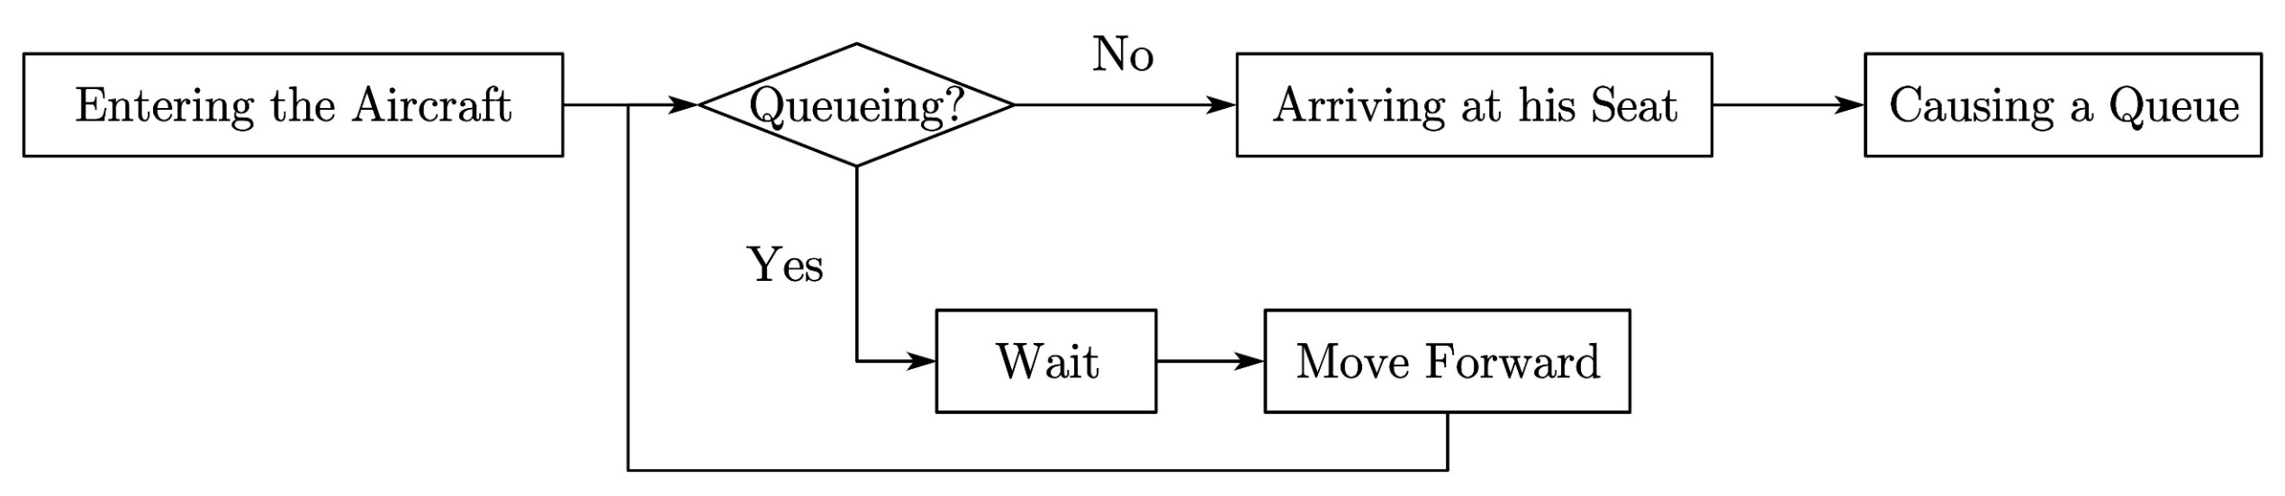
背景 Background
Notes:
To begin with, we will first introduce the overall process boarding, which is shown in this chart on the slide. While boarding a plane, passengers will first go to their assigned seat, put their luggage on the rack and then get seated. While a passenger is stowing their bags, other travelers who are stuck behind in the queue and haven't reached their target seats should wait until the passenger causing the queue finishes the process. This waiting process leads to a queue.

Slide 4
任务分割 Our Work
设计出一个可以计算出登机离机时间且可以应用于所有机型的模型。
Design a model which can calculate the time required to board and disembark which can be applied to all kinds of planes.
在考虑不同情况，乘客满意度和突发状况的情况下优化模型，并根据模型结果初步制定出完整方案。
Improve the model considering different situations, satisfaction degree of passengers and emergency events and design a brief strategy based on the results of our model.
将我们的模型应用于真实飞机上，找到使登离机时间最小化的方案。
Apply our model to real-life planes and find out the best strategy which minimizes the boarding and disembarking time.
Notes:
Based on previous investigations on the boarding process and the correspondent requirements, we made a comprehensive structure of our model.

Slide 5
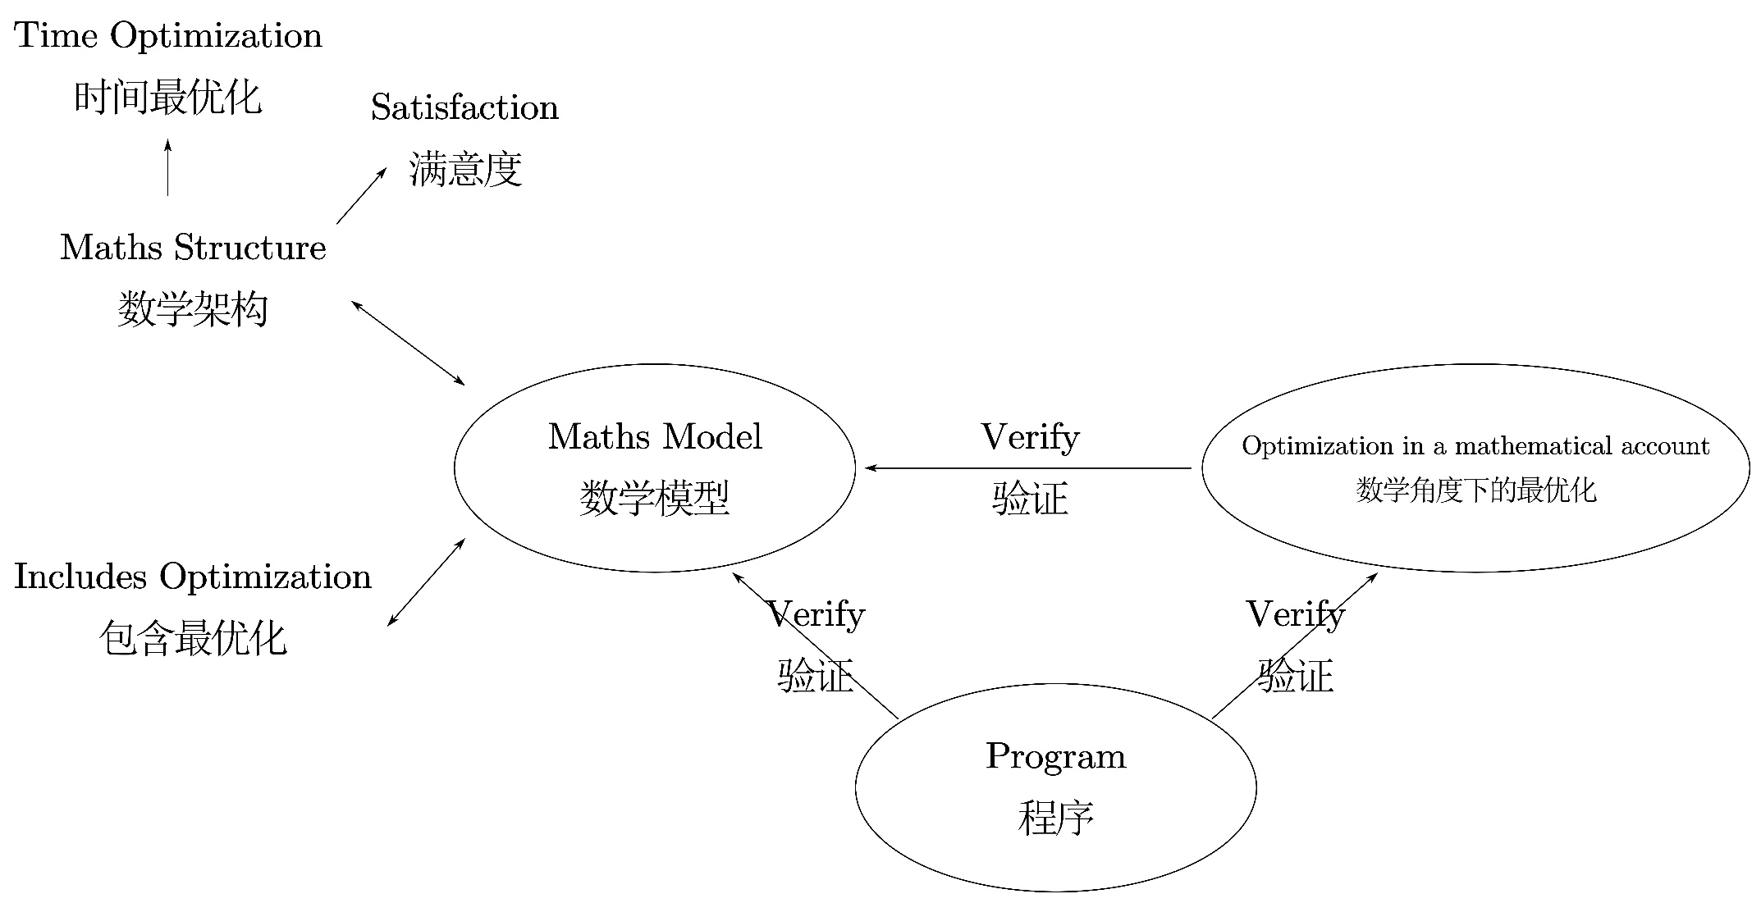
模型结构 Model Structure
图 本模型的结构
Fig. The structure of our model
Notes:
Our model can be divided into three parts: Maths Model, Optimization in a mathematical account and Program. The program part can verify the other two parts, and the optimization part can verify the models. The maths model part mainly discusses the factors that decide a plan is good or not: total boarding time and passenger satisfaction, and also includes some optimization. The optimization part is about ways to make the strategy better. And the program part is to simulate the boarding process, to verify our conclusion given by the model part.

Slide 6
总假设 General Assumptions
每名乘客都会将自己的行李放在自己座位的正上方。
For each passenger, their luggage is put on the rack above them.
航空公司一般都会保证这件事，以避免不必要的拥堵。
Airlines usually ensure this fact to minimize unnecessary congestion.
所有乘客的取行李和放行李的标准时间都相同。
For a certain passenger, the time to lay down his luggage and the time to remove it is the same.
这一过程可以被数学地看作可逆的（想象时间倒流）。
This process can be mathematically acknowledged as reversible (Consider when time relapses).
过道的宽度恰好能容纳一名乘客。
The total width of a passenger and his luggage is similar to the width between rows.
为了提供乘客最好的飞行体验，航空公司需要找到一个既能满足乘客需要又能最大化载客量的列间距。
To provide the passengers with the best flying experience, the airline company needs to find a width between rows which will both satisfy the needs of people and maximize the plane’s capacity.
这可以把连续模型变为离散的并简化计算。
This can turn the continuous model into a discrete model to simplify the calculation.
Notes:
The inherent structure of the problem indicates that our model will be discrete. Therefore, apart from the intuitive ones, other assumptions, such as the third one in this slide, will hinge on this property of discreteness. On the other hand, it’s also important to make our assumptions plausible. This is the main reason for making most of the seemingly impulsive hypothesis afterwards.

Slide 7
总假设 General Assumptions
所有乘客在过道中的最大速度相等。
All passengers walk at the same speed on the aisles.
虽然会有年龄和性别造成的能量差异，乘客们在飞机上行走寻找座位的速度是差不多的。因此，我们可以忽略这一差异并假设所有乘客都以一个相同的理想速度行走。
Though there are energy difference caused by age and sex, there is slight difference of walking velocity when different passengers walk on a plane searching for their assigned seat. Therefore, we can neglect the difference and assume that all the passengers have the same speed.
乘客只会朝着自己座位的方向移动，而不会往回走。
Passengers never go backward.
大多数乘客专注于找座位，因此他们很少迷路并走回头路。
Most passengers are concentrated on finding their seat most. Therefore, they seldom miss their way and try to move backward
Notes:
These two assumptions are about the moving state of passengers and we’ve given correspondent justifications.

Slide 8
总假设 General Assumptions
头等舱和商务舱乘客会优先登机。
First and business class passengers are prioritized with respect to those of the economic class.
虽然（根据论文中的最终结果）这并不是对所有机型和乘客的最佳策略，让贵宾先登机会让他们更满足，从而增大航空公司收入。因此我们考虑这一因素以让模型更真实。
Although (according to the ultimate results displayed in our essay), this is not the best boarding strategy for any types of plane and passengers, letting distinguished guests board first will give these passengers a sense of satisfaction and enlarge the airline company’s income. Therefore, we took this fact into consideration to make our model more realistic.
乘客给其他乘客让座时的横移速度等于其在过道中的最大速度。
The horizontal velocity of passengers offering seats is equal to the maximum speed in the aisle.
在让座时，乘客不会被其他乘客堵住。并且由于手中行李和身边座位的影响差不多，我们可以假设乘客在飞机上的最大横移速度等于他们的最大走动速度。
Passengers wouldn’t be blocked when offering seats. And it’s reasonable to assume that the horizontal and vertical velocity is approximately the same, for the impact of the luggage in hand and the seats beside a passenger are approximately the same.
Notes:
These assumptions are respectively proposed to simulate reality and to simplify our calculations.

Slide 9
时间计算 - 假设 Assumptions for Time Calculating
行李架足够大，能容纳任意大小的行李。
The luggage racks are designed to be adequate for any reasonable amount of luggage.
每名乘客能携带的行李量有限
There’s a limit on the amount of luggage each passenger can bring
把行李放在行李架上和把行李挤到座位里在时间上相等
It’s the (for time) the same as putting luggage into the rack if a passenger puts the luggage into the seat
乘客每时每刻会以其当时可能达到的最大速度行走。
Passengers always maintain their maximum theoretical speed at that time.
乘客一般会尽快就座，因此合理的假设是乘客总以可能的最大速度行进。
Passengers usually want to get seated as quickly as possible, so it’s reasonable to assume that passengers always walk as quickly as possible.
Notes:
Here are the assumptions of Model A. In Model A, we would consider the single-aisle case (although in our presentation we tend to combine it with other types of aircraft due to their similar deduction methods). It’s important to note that since we’ll vary the stowing time of passengers in the later slides, the first assumption is rather reasonable. The time wasted while passengers try to stuff extra luggage into their seats is qualitatively equivalent to that spent while stowing those extra luggage.
For the second assumption on this slide, we disambiguated the expression in or essay by using this interpretation: passengers always maintain maximum theoretical speed. A corollary to this is that queuing has the same effect on a block of adjacent passengers.

Slide 10
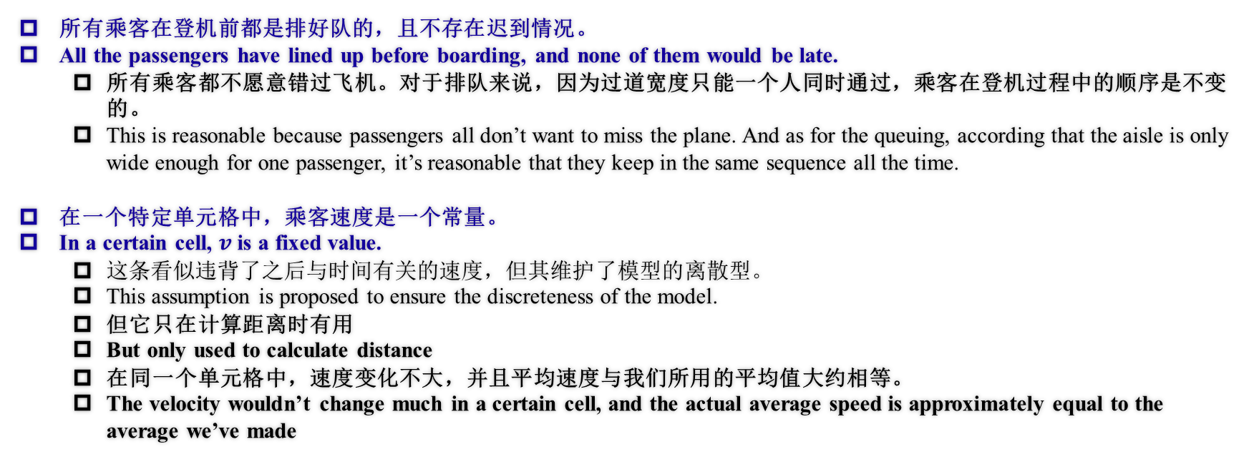
时间计算 - 假设 Assumptions for Time Calculating
所有乘客在登机前都是排好队的，且不存在迟到情况。
All the passengers have lined up before boarding, and none of them would be late.
所有乘客都不愿意错过飞机。对于排队来说，因为过道宽度只能一个人同时通过，乘客在登机过程中的顺序是不变的。
This is reasonable because passengers all don’t want to miss the plane. And as for the queuing, according that the aisle is only wide enough for one passenger, it’s reasonable that they keep in the same sequence all the time.
在一个特定单元格中，乘客速度是一个常量。
In a certain cell, $v$ is a fixed value.
这条看似违背了之后与时间有关的速度，但其维护了模型的离散型。
This assumption is proposed to ensure the discreteness of the model.
但它只在计算距离时有用
But only used to calculate distance
在同一个单元格中，速度变化不大，并且平均速度与我们所用的平均值大约相等。
The velocity wouldn’t change much in a certain cell, and the actual average speed is approximately equal to the average we’ve made
Notes:
Here are the last two assumptions. We’ll explain the second assumption soon afterwards.

Slide 11
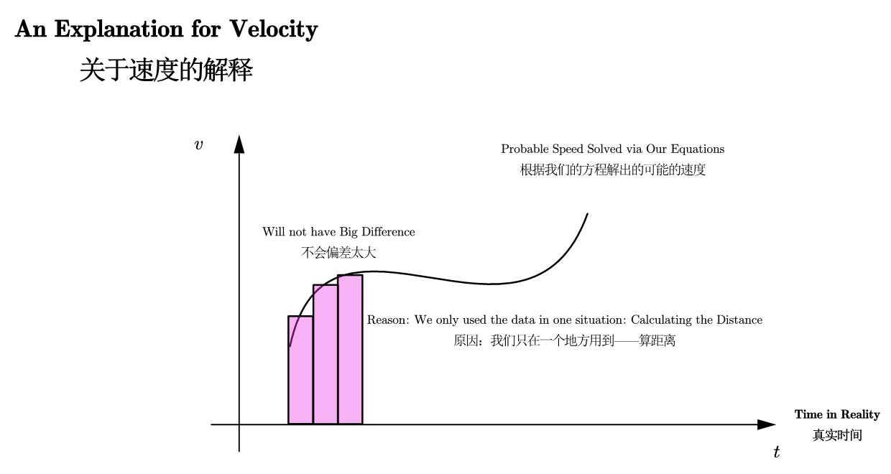
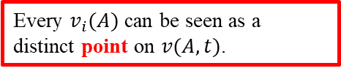
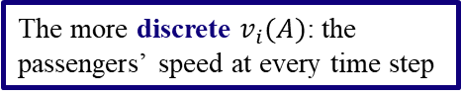
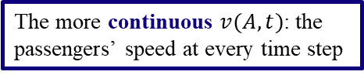
假设的解释 Justification for the Assumption
关于最后一条假设的解释
The explanation of the last assumption made in the previous slide
The more continuous $v(A,t)$: the passengers’ speed at every time step
The more discrete $v_{i}(A)$: the passengers’ speed at every time step
Every $v_{i}(A)$ can be seen as a distinct point on $v(A,t)$.
Therefore, the summation (or integral) of these two defined velocities will roughly amount to the same value.
Notes:
As for the velocity, we assume that the velocity in a certain cell remains constant. This means that V_i(A) could be thought as points on the velocity function. Though it might not be so realistic, this assumption enables us to simplify the calculation for the velocity (for it was only used when calculating distance) and wouldn't cause a lot of inaccuracy (meaning that it wouldn't cause much change to the total time), as shown in the graph. This is partly because the basic timestep is only 1/6 sec, a very short time that wouldn't influence the velocity and distribution of passengers much, and thus according to the formula of calculating velocity, the velocity in a certain timestep wouldn't change much, so it can be seen as a constant.

Slide 12
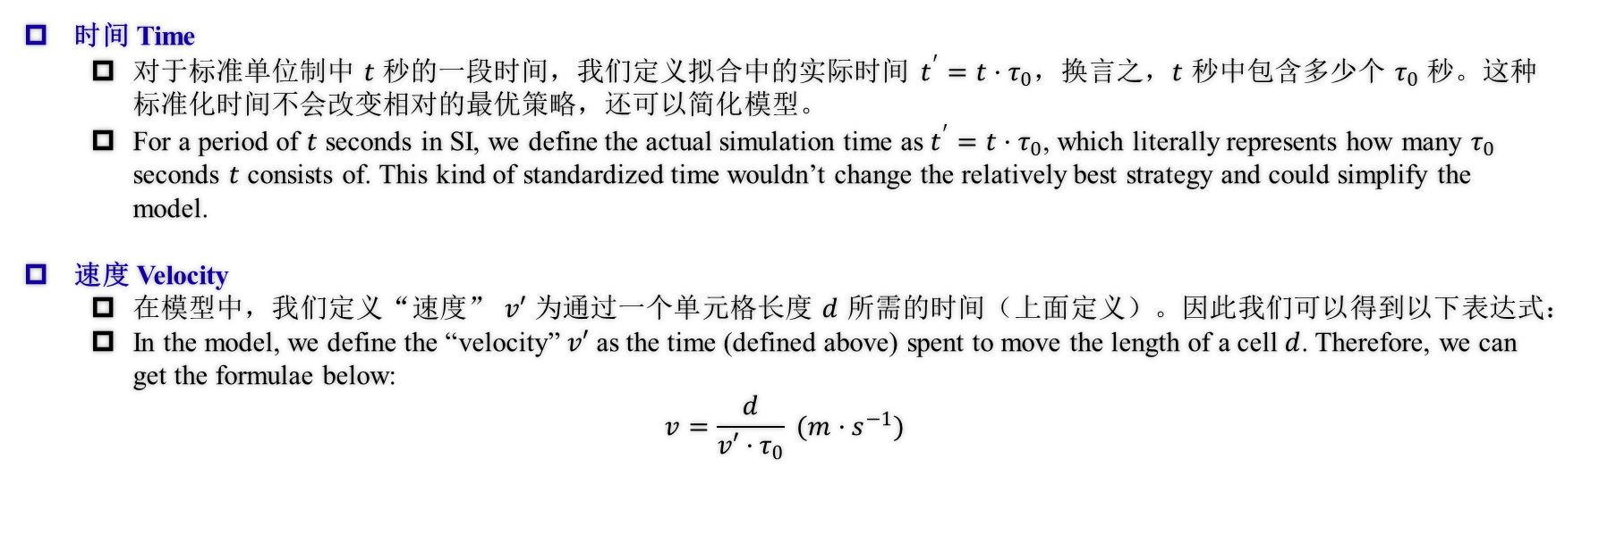
定义 Definitions
时间 Time
对于标准单位制中 $t$ 秒的一段时间，我们定义拟合中的实际时间 $t^{′}=t·τ_{0}$，换言之，$t$ 秒中包含多少个 $τ_{0}$ 秒。这种标准化时间不会改变相对的最优策略，还可以简化模型。
For a period of $t$ seconds in SI, we define the actual simulation time as $t^{′}=t·τ_{0}$, which literally represents how many $τ_{0}$ seconds $t$ consists of. This kind of standardized time wouldn’t change the relatively best strategy and could simplify the model.
速度 Velocity
在模型中，我们定义“速度” $v′$ 为通过一个单元格长度 $d$ 所需的时间（上面定义）。因此我们可以得到以下表达式：
In the model, we define the “velocity” $v′$ as the time (defined above) spent to move the length of a cell $d$. Therefore, we can get the formulae below:
$$v=\frac{d}{v′·τ_{0}} (m·s^{−1})$$
Notes:
In the model, the definition of time and velocity is different from SI, and this is the relationship between SI time and velocity and ours. We make these changes to make the calculations simpler.

Slide 13
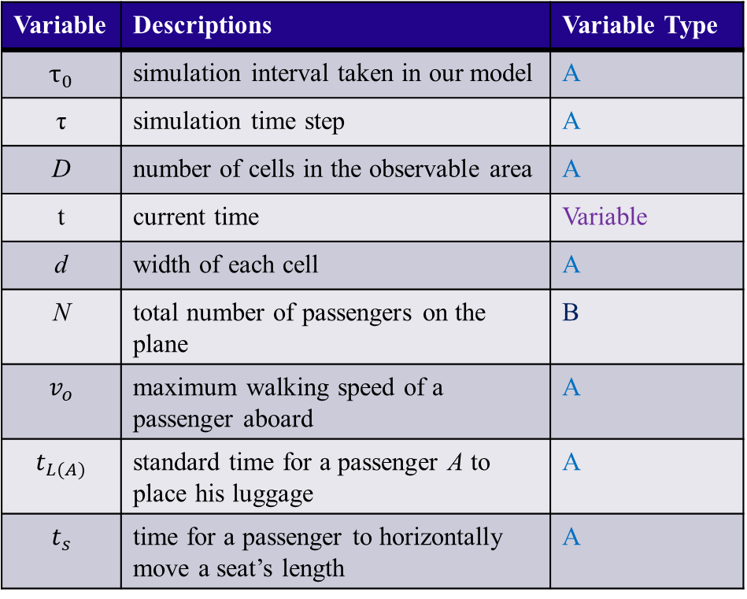
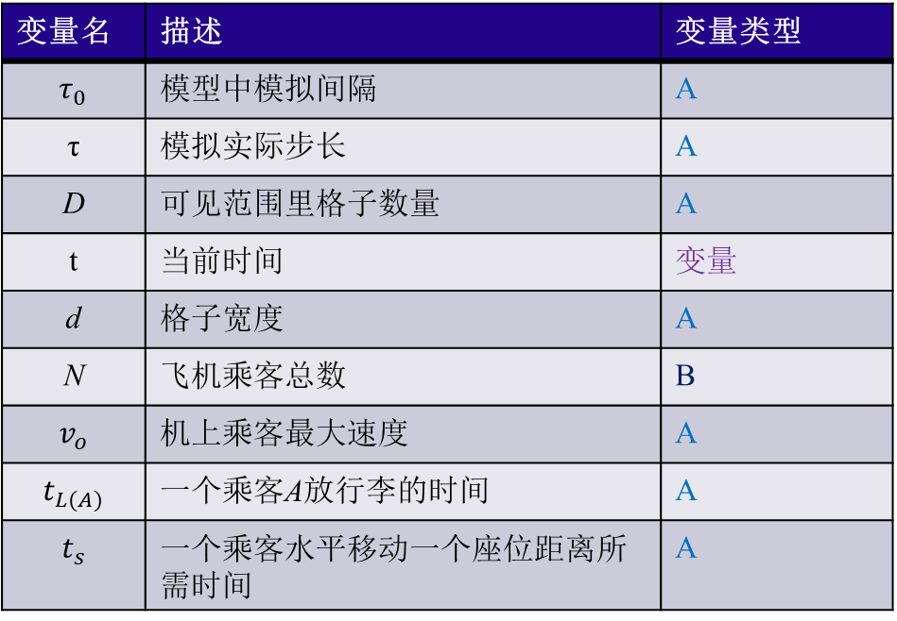
变量表 Notations
Variable | Descriptions | Variable Type
$$τ_{0}$$ | simulation interval taken in our model | A
τ | simulation time step | A
D | number of cells in the observable area | A
t | current time | Variable
d | width of each cell | A
N | total number of passengers on the plane | B
$$v_{o}$$ | maximum walking speed of a passenger aboard | A
$$t_{L(A)}$$ | standard time for a passenger A to place his luggage | A
$$t_{s}$$ | time for a passenger to horizontally move a seat’s length | A
变量名 | 描述 | 变量类型
$$τ_{0}$$ | 模型中模拟间隔 | A
τ | 模拟实际步长 | A
D | 可见范围里格子数量 | A
t | 当前时间 | 变量
d | 格子宽度 | A
$$\text{N}$$ | 飞机乘客总数 | B
$$v_{o}$$ | 机上乘客最大速度 | A
$$t_{L(A)}$$ | 一个乘客A放行李的时间 | A
$$t_{s}$$ | 一个乘客水平移动一个座位距离所需时间 | A
Notes:
Here are the no

Slide 14
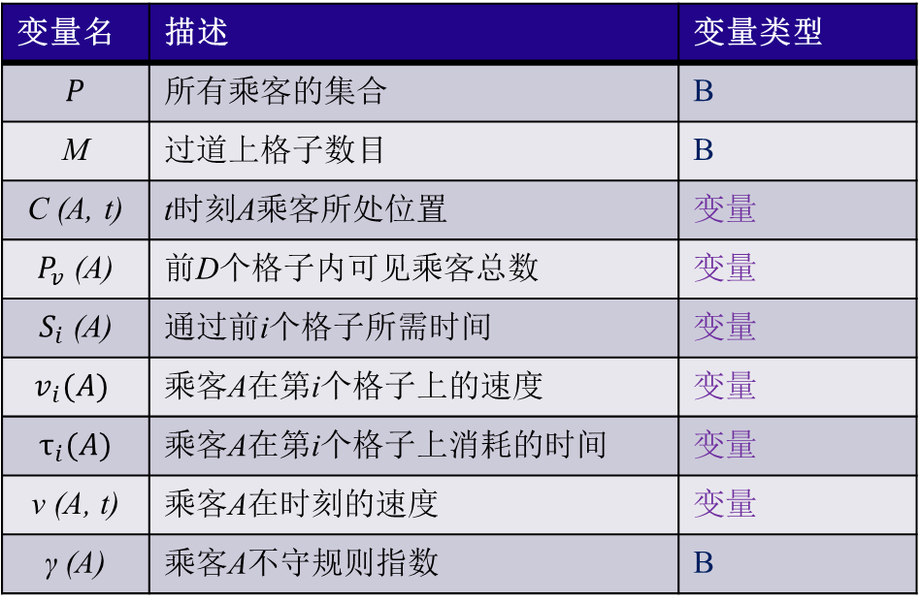
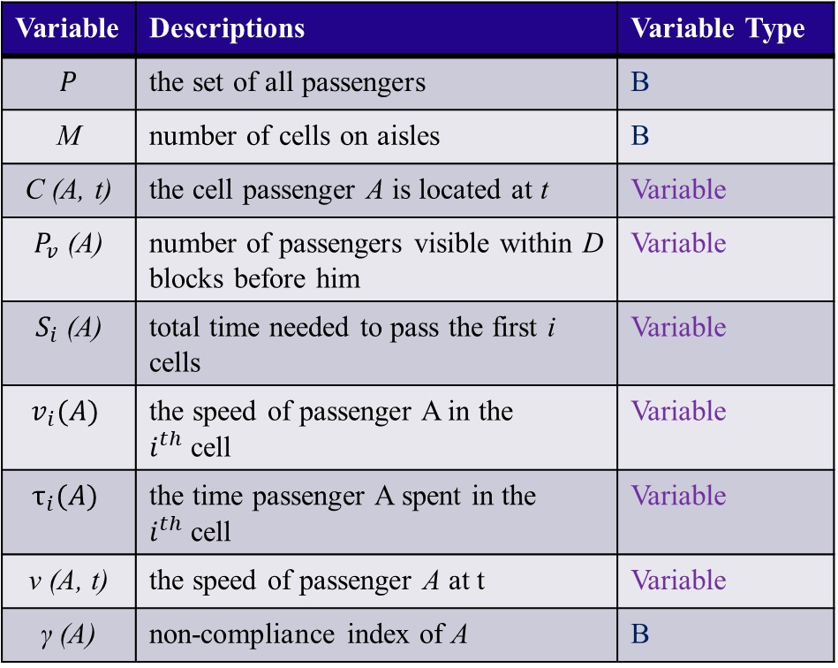
变量表 Notations
Variable | Descriptions | Variable Type
$$P$$ | the set of all passengers | B
M | number of cells on aisles | B
C (A, t) | the cell passenger A is located at t | Variable
$P_{v}$ (A) | number of passengers visible within D blocks before him | Variable
$S_{i}$ (A) | total time needed to pass the first i cells | Variable
$$v_{i}(A)$$ | the speed of passenger A in the $i^{th}$cell | Variable
$$τ_{i}(A)$$ | the time passenger A spent in the $i^{th}$cell | Variable
$$\text{v}\text{ (}\text{A}\text{, }\text{t}\text{)}$$ | the speed of passenger A at t | Variable
$$\text{γ}\text{ (}\text{A}\text{)}$$ | non-compliance index of A | B
变量名 | 描述 | 变量类型
$$P$$ | 所有乘客的集合 | B
M | 过道上格子数目 | B
C (A, t) | t时刻A乘客所处位置 | 变量
$P_{v}$ (A) | 前D个格子内可见乘客总数 | 变量
$S_{i}$ (A) | 通过前i个格子所需时间 | 变量
$$v_{i}(A)$$ | 乘客A在第i个格子上的速度 | 变量
$$τ_{i}(A)$$ | 乘客A在第i个格子上消耗的时间 | 变量
$$\text{v}\text{ (}\text{A}\text{, }\text{t}\text{)}$$ | 乘客A在时刻的速度 | 变量
$$\text{γ}\text{ (}\text{A}\text{)}$$ | 乘客A不守规则指数 | B

Slide 15
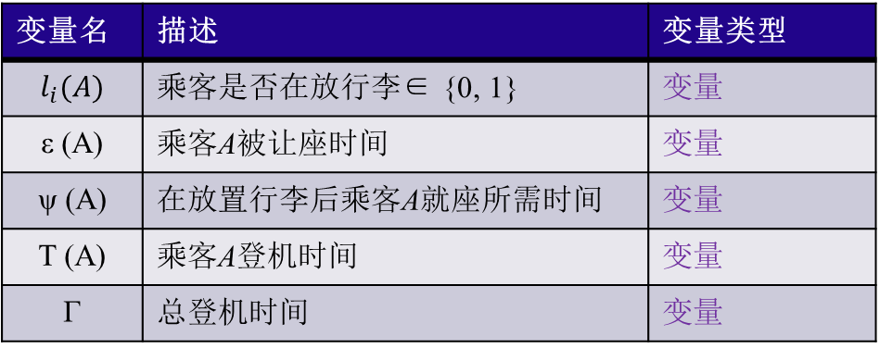
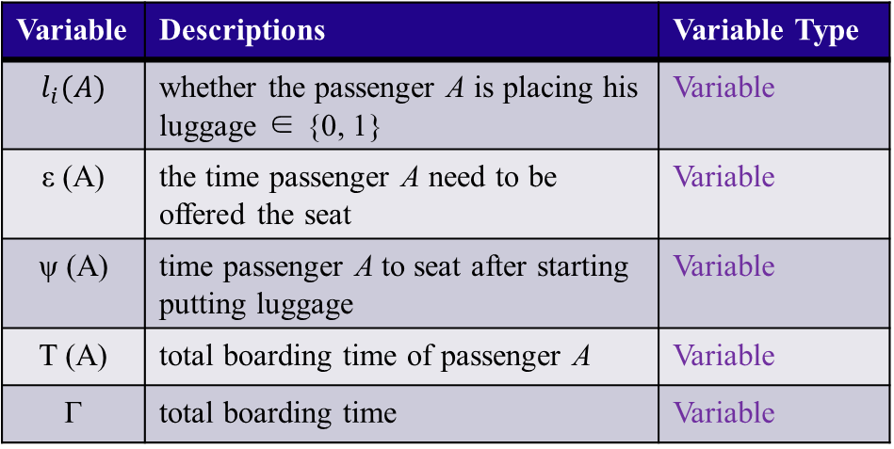
变量表 Notations
Variable | Descriptions | Variable Type
$$l_{i}(A)$$ | whether the passenger A is placing his luggage ∈ {0, 1} | Variable
ε (A) | the time passenger A need to be offered the seat | Variable
ψ (A) | time passenger A to seat after starting putting luggage | Variable
T (A) | total boarding time of passenger A | Variable
Γ | total boarding time | Variable
变量名 | 描述 | 变量类型
$$l_{i}(A)$$ | 乘客是否在放行李∈ {0, 1} | 变量
ε (A) | 乘客A被让座时间 | 变量
ψ (A) | 在放置行李后乘客A就座所需时间 | 变量
T (A) | 乘客A登机时间 | 变量
Γ | 总登机时间 | 变量

Slide 16
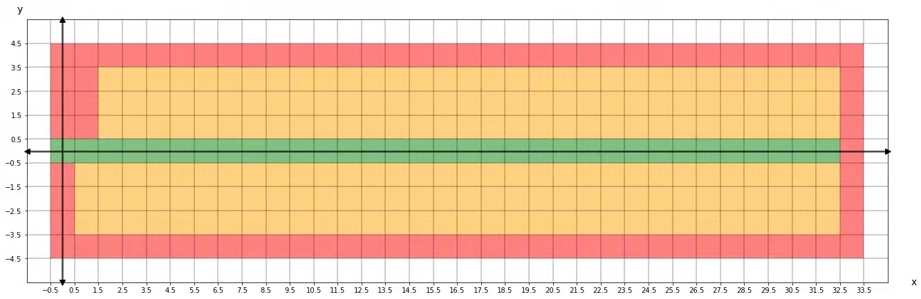
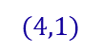
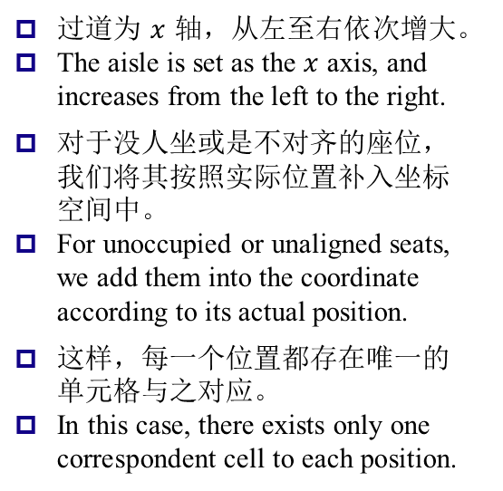
构建数学模型计算登机时间（常规状态） Devising a Model to Calculate Total Boarding Time (Under Regular States)
这一部分中，我们将采用逐步推演的方式较为清晰地展示乘客速度之间的关系。
In this part, we’ll carefully deduct and explicitly display the connections between the passengers’ velocities.
坐标系的构建 - The construction of the coordinate
过道为$x$轴，从左至右依次增大。
The aisle is set as the $x$ axis, and increases from the left to the right.
对于没人坐或是不对齐的座位，我们将其按照实际位置补入坐标空间中。
For unoccupied or unaligned seats, we add them into the coordinate according to its actual position.
这样，每一个位置都存在唯一的单元格与之对应。
In this case, there exists only one correspondent cell to each position.
$$(4,1)$$
Cell 1
Cell 2
图 坐标系的构建
Fig. The construction of the coordinate
比如该墙体仍然被当作坐标格处理
For example, this wall is still taken as several cells.
Notes:
In this part we would calculate the velocity according to the density. The density defined in the model is as shown in the slide. The visibility range is taken as 4 because 4 is not too big or too small and is realistic, and it also decides the timestep (if taken as 4, the timestep can be 1/6 or 1/12 sec), reducing the complexity of simulation.

Slide 17
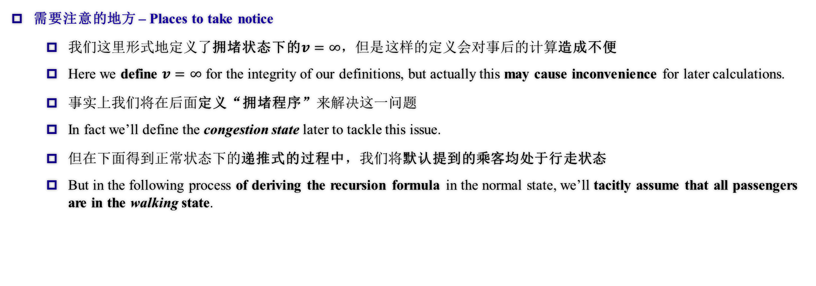
构建数学模型计算登机时间（常规状态） Devising a Model to Calculate Total Boarding Time (Under Regular States)
需要注意的地方 – Places to take notice
我们这里形式地定义了拥堵状态下的$v=∞，但是$这样的定义会对事后的计算造成不便
Here we define $v=∞$ for the integrity of our definitions, but actually this may cause inconvenience for later calculations.
事实上我们将在后面定义“拥堵程序”来解决这一问题
In fact we’ll define the congestion state later to tackle this issue.
但在下面得到正常状态下的递推式的过程中，我们将默认提到的乘客均处于行走状态
But in the following process of deriving the recursion formula in the normal state, we’ll tacitly assume that all passengers are in the walking state.
Notes:
We use Greenshields speed-density linear model (Ref. 3 in essay) to evelop the relation between v and D. The formulae is shown in the slide.

Slide 18
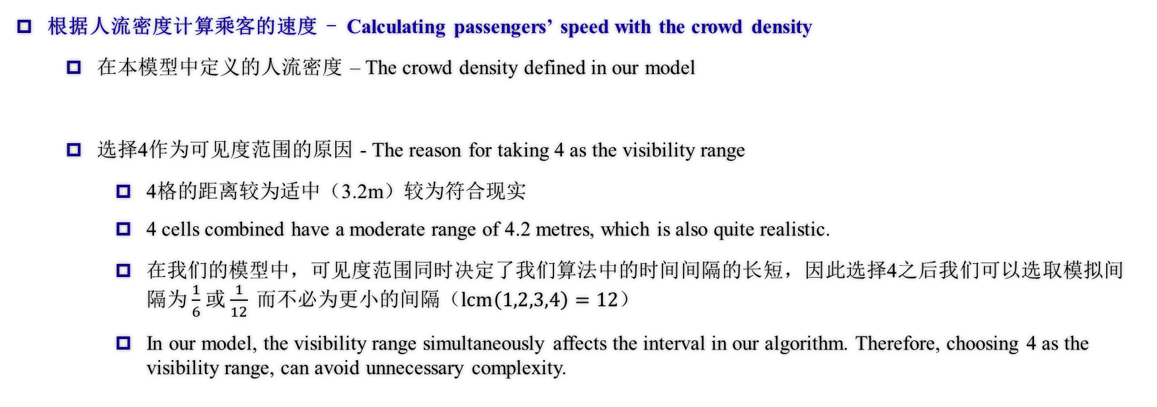
构建数学模型计算登机时间（常规状态） Devising a Model to Calculate Total Boarding Time (Under Regular States)
根据人流密度计算乘客的速度 - Calculating passengers’ speed with the crowd density
在本模型中定义的人流密度 – The crowd density defined in our model
选择4作为可见度范围的原因 - The reason for taking 4 as the visibility range
4格的距离较为适中（3.2m）较为符合现实
4 cells combined have a moderate range of 4.2 metres, which is also quite realistic.
在我们的模型中，可见度范围同时决定了我们算法中的时间间隔的长短，因此选择4之后我们可以选取模拟间隔为$\frac{1}{6}$或$\frac{1}{12} 而$不必为更小的间隔（$lcm\left(1,2,3,4\right)=12$）
In our model, the visibility range simultaneously affects the interval in our algorithm. Therefore, choosing 4 as the visibility range, can avoid unnecessary complexity.
Notes:
ATS

Slide 19
构建数学模型计算登机时间（常规状态） Devising a Model to Calculate Total Boarding Time (Under Regular States)
根据人流密度计算乘客的速度 - Calculating passengers’ speed with the crowd density
格林希尔茨（Greenshields）速度-人流密度线性关系模型（论文中引用3）
Greenshields speed-density linear model (Ref. 3 in essay)
Notes:
When boarding, as the sequence is constant, we can calculate directly with the given queue.

Slide 20
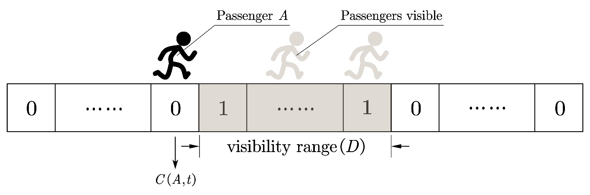
构建数学模型计算登机时间（常规状态） Devising a Model to Calculate Total Boarding Time (Under Regular States)
根据乘客分布计算人流密度 – Calculating crowd density under a given passenger distribution
由两个分别代表乘客“能见度”与过道中乘客状态分布的向量数乘得到
Calculated through the dot product of two vectors which respectively represent the passenger’s visibility and the overall distribution in the aisle. (or the existence factor)
这样，我们得到了乘客能见度与乘客分布的线性积关系。
In this case, we’ve got the linear product relation between visibility and the overall crowd distribution.
图 两个向量的直观表示
Fig. The intuitive illustration of the visibility and existence vectors
Notes:
ATS

Slide 21
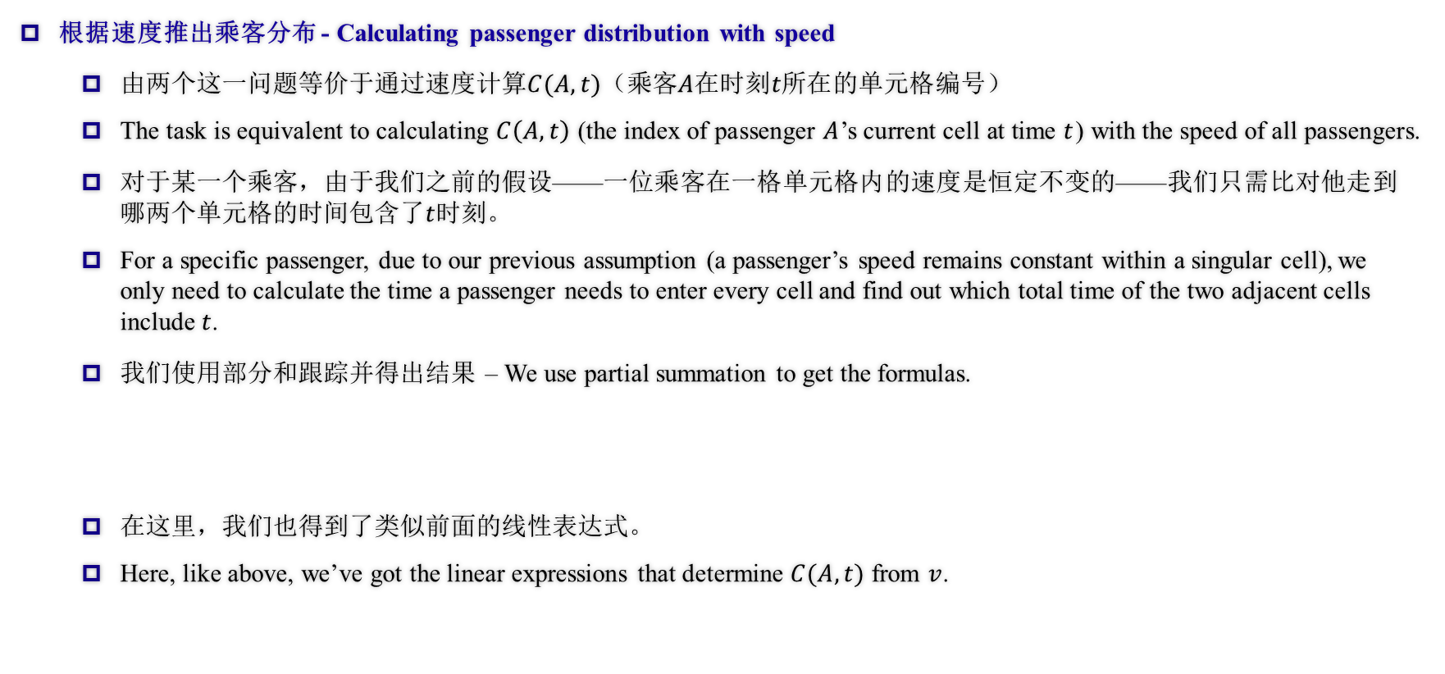
构建数学模型计算登机时间（常规状态） Devising a Model to Calculate Total Boarding Time (Under Regular States)
根据速度推出乘客分布 - Calculating passenger distribution with speed
由两个这一问题等价于通过速度计算$C(A,t)$（乘客$A$在时刻$t所在$的单元格编号）
The task is equivalent to calculating $C\left(A,t\right)$ (the index of passenger $A$’s current cell at time $t$) with the speed of all passengers.
对于某一个乘客，由于我们之前的假设——一位乘客在一格单元格内的速度是恒定不变的——我们只需比对他走到哪两个单元格的时间包含了$t$时刻。
For a specific passenger, due to our previous assumption (a passenger’s speed remains constant within a singular cell), we only need to calculate the time a passenger needs to enter every cell and find out which total time of the two adjacent cells include $t$.
我们使用部分和跟踪并得出结果 – We use partial summation to get the formulas.
在这里，我们也得到了类似前面的线性表达式。
Here, like above, we’ve got the linear expressions that determine $C(A,t)$ from $v$.
Notes:
ATS

Slide 22
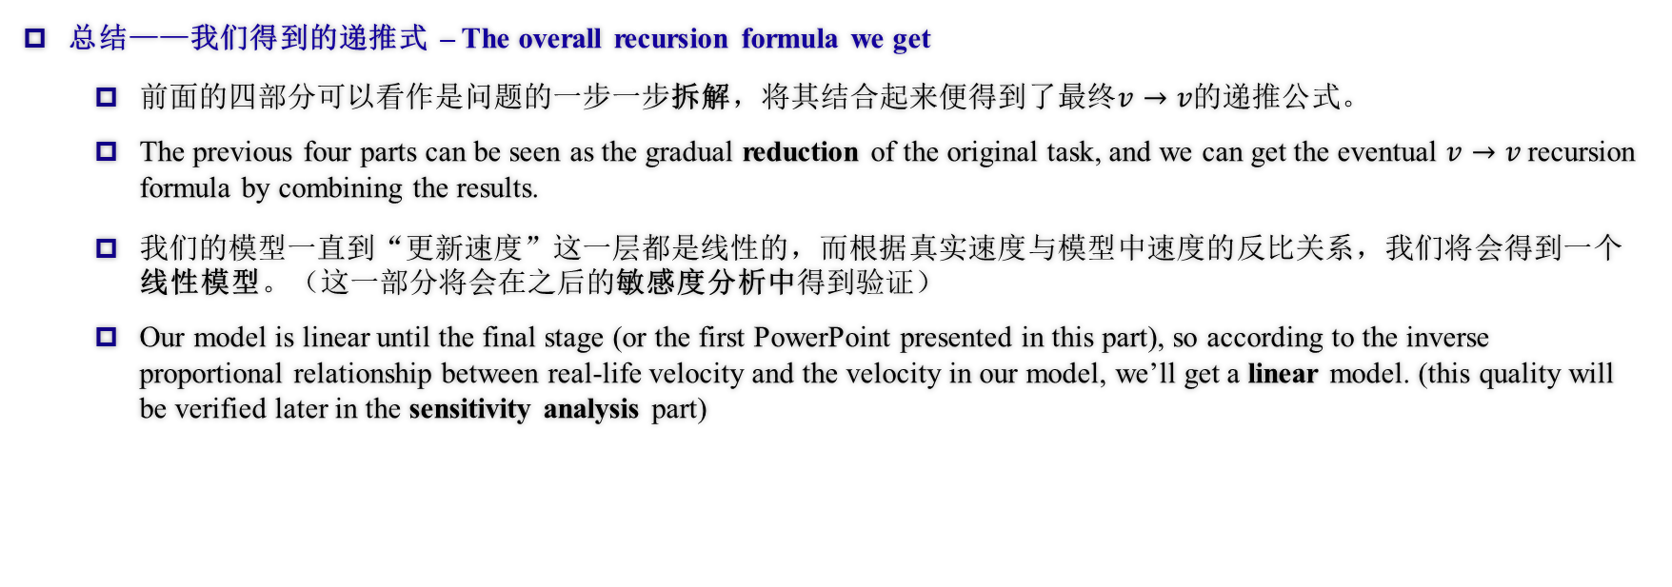
构建数学模型计算登机时间（常规状态） Devising a Model to Calculate Total Boarding Time (Under Regular States)
总结——我们得到的递推式 – The overall recursion formula we get
前面的四部分可以看作是问题的一步一步拆解，将其结合起来便得到了最终$v→v$的递推公式。
The previous four parts can be seen as the gradual reduction of the original task, and we can get the eventual $v→v$ recursion formula by combining the results.
我们的模型一直到“更新速度”这一层都是线性的，而根据真实速度与模型中速度的反比关系，我们将会得到一个线性模型。（这一部分将会在之后的敏感度分析中得到验证）
Our model is linear until the final stage (or the first PowerPoint presented in this part), so according to the inverse proportional relationship between real-life velocity and the velocity in our model, we’ll get a linear model. (this quality will be verified later in the sensitivity analysis part)
Notes:
ATS

Slide 23
构建数学模型计算登机时间（常规状态） Devising a Model to Calculate Total Boarding Time (Under Regular States)
总结——我们得到的递推式 – The overall recursion formula we get
因此，我们可以得到下述由前一时刻所有乘客的速度状态组的线性组合得到的线性递推公式。
Therefore we can get the linear recursion formula with the full state of passenger velocities as the previous time step, as shown below.
Notes:
ATS

Slide 24
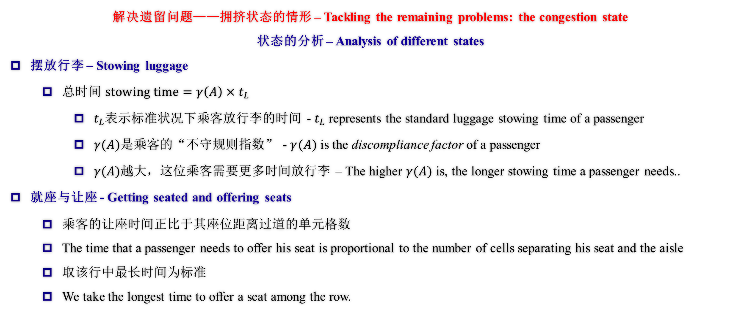
构建数学模型计算登机时间（拥挤状态） Devising a Model to Calculate Total Boarding Time (Under the Crowded States)
解决遗留问题——拥挤状态的情形 – Tackling the remaining problems: the congestion state
状态的分析 – Analysis of different states
摆放行李 – Stowing luggage
总时间 $stowing time=γ\left(A\right)×t_{L}$
$t_{L}$表示标准状况下乘客放行李的时间 - $t_{L}$ represents the standard luggage stowing time of a passenger
$γ(A)$是乘客的“不守规则指数” - $γ(A)$ is the discompliance factor of a passenger
$γ(A)$越大，这位乘客需要更多时间放行李 – The higher $γ(A)$ is, the longer stowing time a passenger needs..
就座与让座 - Getting seated and offering seats
乘客的让座时间正比于其座位距离过道的单元格数
The time that a passenger needs to offer his seat is proportional to the number of cells separating his seat and the aisle
取该行中最长时间为标准
We take the longest time to offer a seat among the row.
Notes:
This is the algorithm we use to deal with congestion.

Slide 25
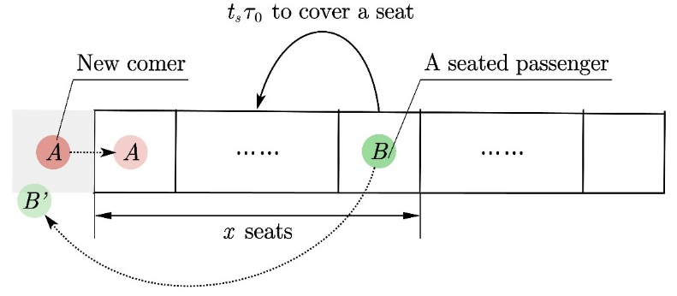
构建数学模型计算登机时间（拥挤状态） Devising a Model to Calculate Total Boarding Time (Under the Crowded States)
解决遗留问题——拥挤状态的情形 – Tackling the remaining problems: the congestion state
状态的分析 – Analysis of different states
就座 - Getting seated and offering seats
仔细看来，加入初始状态是确定的，那么让座时间便可以直接通过队列的顺序计算。
Under close inspection, if the original state is given, then the time to offer seats can be calculated.
对于某一行的乘客，由于不存在超到前面去的情况，到达这一行的乘客从前到后的顺序与他们一开始在队列中的顺序完全相同，因此可以据此事实直接计算。
For passengers in a specific row, since it’s not allowed to surpass anyone before them, the arrival sequence of this row’s passengers is the same as their original position in the queue. Therefore, we can calculate the total time of offering seats directly based on the given queue.
图 让座程序
Fig. Offering a seat
Notes:
When boarding, as the sequence is constant, we can calculate directly with the given queue.

Slide 26
构建数学模型计算登机时间（拥挤状态） Devising a Model to Calculate Total Boarding Time (Under the Crowded States)
解决遗留问题——拥挤状态的情形 – Tackling the remaining problems: the congestion state
状态的分析 – Analysis of different states
就座 - Getting seated and offering seats
图 让座程序
Fig. Offering a seat
Notes:
This figure shows the process of offering seats.

Slide 27
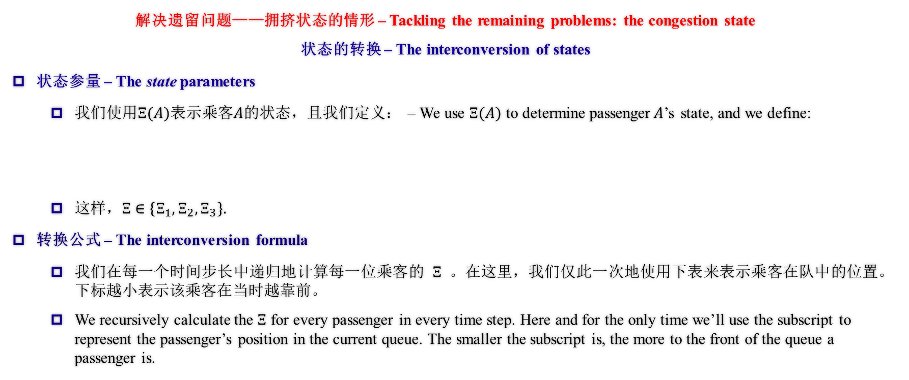
构建数学模型计算登机时间（拥挤状态） Devising a Model to Calculate Total Boarding Time (Under the Crowded States)
解决遗留问题——拥挤状态的情形 – Tackling the remaining problems: the congestion state
状态的转换 – The interconversion of states
状态参量 – The state parameters
我们使用$Ξ(A)$表示乘客$A$的状态，且我们定义： – We use $Ξ(A)$ to determine passenger$A$’s state, and we define:
这样，$Ξ∈\left\{Ξ_{1}, Ξ_{2},Ξ_{3}\right\}.$
转换公式 – The interconversion formula
我们在每一个时间步长中递归地计算每一位乘客的$Ξ$。在这里，我们仅此一次地使用下表来表示乘客在队中的位置。下标越小表示该乘客在当时越靠前。
We recursively calculate the $Ξ$ for every passenger in every time step. Here and for the only time we’ll use the subscript to represent the passenger’s position in the current queue. The smaller the subscript is, the more to the front of the queue a passenger is.
Notes:
ATS

Slide 28
构建数学模型计算登机时间（拥挤状态） Devising a Model to Calculate Total Boarding Time (Under the Crowded States)
解决遗留问题——拥挤状态的情形 – Tackling the remaining problems: the congestion state
状态的转换 – The interconversion of states
转换公式 – The interconversion formula
我们使用了如下方式更新状态，达到效果 – We used the following method to update the states.
最终转换的效果如下。Below is showed the mechanism, which fits with our flow chart as shown in the beginning.
不难发现，最终的关系仍然保持线性。It’s clear that the relationship still remains linear.

Slide 29
构建数学模型计算登机时间（拥挤状态） Devising a Model to Calculate Total Boarding Time (Under the Crowded States)
解决遗留问题——拥挤状态的情形 – Tackling the remaining problems: the congestion state
状态的转换 – The interconversion of states
剔除公式 – Deleting from queue
当乘客到达座位，我们通过将其剔除队列来更新以继续进行运算，不会影响到前述算法。
When a passenger reaches his seat, we delete him from the queue to update and continue with the calculations without affecting the previous model.
Notes:
We would delete seated passengers from the queue.

Slide 30
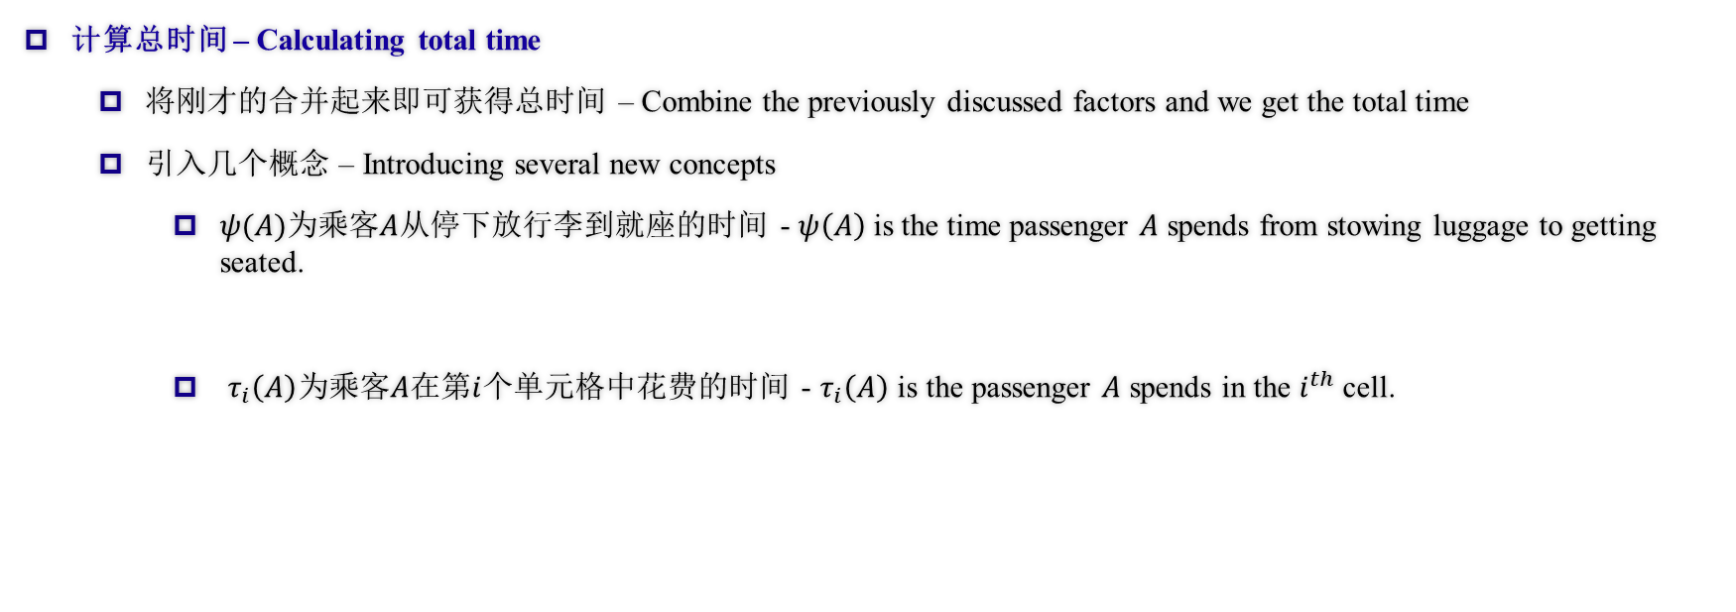
构建数学模型计算登机时间（总时间） Devising a Model to Calculate Total Boarding Time (Total time)
计算总时间 – Calculating total time
将刚才的合并起来即可获得总时间 – Combine the previously discussed factors and we get the total time
引入几个概念 – Introducing several new concepts
$ψ(A)$为乘客$A$从停下放行李到就座的时间 - $ψ\left(A\right)$ is the time passenger $A$ spends from stowing luggage to getting seated.
$τ_{i}\left(A\right)$为乘客$A$在第$i$个单元格中花费的时间 - $τ_{i}\left(A\right)$ is the passenger $A$ spends in the $i^{th}$ cell.
Notes:
We could get the total time combining those calculations together.

Slide 31
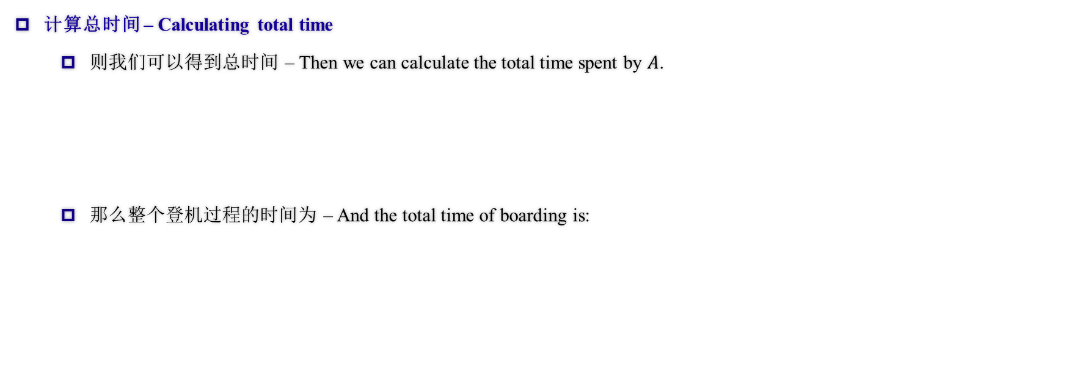
构建数学模型计算登机时间（总时间） Devising a Model to Calculate Total Boarding Time (Total time)
计算总时间 – Calculating total time
则我们可以得到总时间 – Then we can calculate the total time spent by $A$.
那么整个登机过程的时间为 – And the total time of boarding is:
Notes:
The final total time is the maximum total time among all passengers.

Slide 32
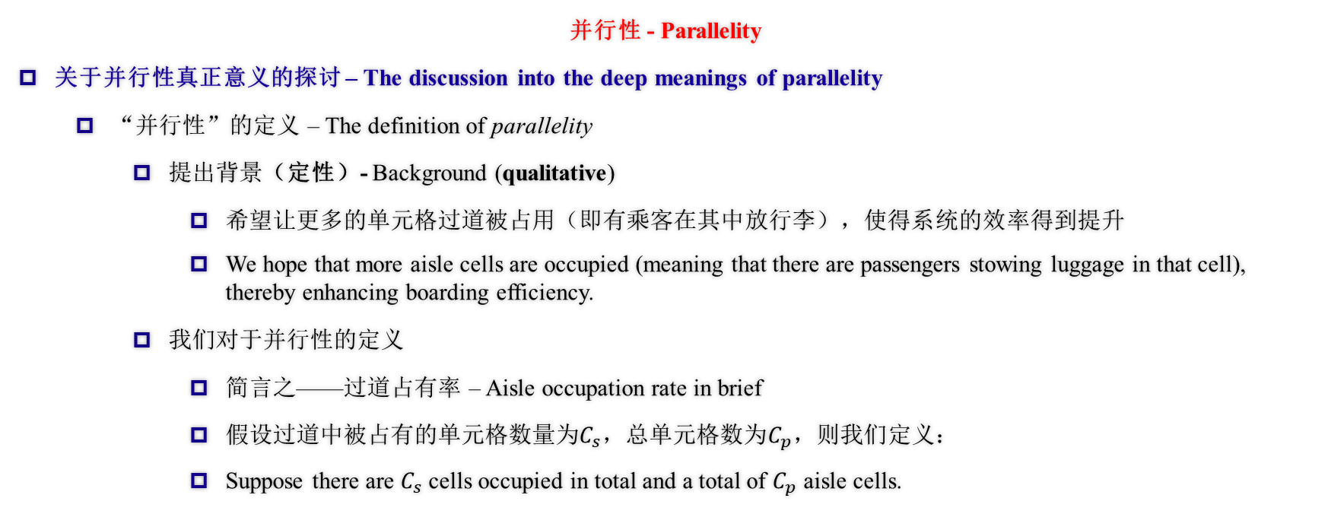
构建数学模型计算登机时间（并行性） Devising a Model to Calculate Total Boarding Time (Parallelity)
并行性 - Parallelity
关于并行性真正意义的探讨 – The discussion into the deep meanings of parallelity
“并行性”的定义 – The definition of parallelity
提出背景（定性）- Background (qualitative)
希望让更多的单元格过道被占用（即有乘客在其中放行李），使得系统的效率得到提升
We hope that more aisle cells are occupied (meaning that there are passengers stowing luggage in that cell), thereby enhancing boarding efficiency.
我们对于并行性的定义
简言之——过道占有率 – Aisle occupation rate in brief
假设过道中被占有的单元格数量为$C_{s}$，总单元格数为$C_{p}$，则我们定义：
Suppose there are $C_{s}$ cells occupied in total and a total of $C_{p}$ aisle cells.
Notes:
We introduced parallelity to describe how many of the aisle cells are occupied (and used). The higher the parallelity, the more efficient the system is, and the faster the strategy is. The formulae of parallelity is shown in the slide.

Slide 33
构建数学模型计算登机时间（并行性） Devising a Model to Calculate Total Boarding Time (Parallelity)
并行性 - Parallelity
关于并行性真正意义的探讨 – The discussion into the deep meanings of parallelity
“模型基础”（半定量分析）- Model basis (semi-quantitative analysis)
前述计算表明乘客的速度遵循递推式，并且遵循线性模型的关系
Previous calculations infer that the velocities of passengers follow a recursion formula and that they follow a linear pattern.
而想让总时间变小，本模型中定义的“速度”需要尽量小
Therefore, in order to minimize total time, the speed (the one defined in our model) should also be minimized.
Notes:
ats

Slide 34
构建数学模型计算登机时间（并行性） Devising a Model to Calculate Total Boarding Time (Parallelity)
并行性 - Parallelity
关于并行性真正意义的探讨 – The discussion into the deep meanings of parallelity
“模型基础”（半定量分析）- Model basis (semi-quantitative analysis)
因此希望让“速度”的增加次数尽可能小，或是尽可能长时间维持在最小值
That’s why we want the speed to increase fewer times or maintain its minimum for a long period of time.
所以希望过道的占用率更大，这样乘客能够保持更长时间（现实中的）的最大速度，直到所有在过道中的人再次开始放行李
So by hoping the aisle has higher occupancy, passengers can maintain the maximum speed (in reality) until all the passengers in the aisle start stowing luggage again.
因此我们使用“过道占有率”来作为总时间的衡量指标
Therefore we use aisle occupancy to measure total time.
Notes:
So we hope that passengers can maintain a realistic maximum speed until the passengers in the aisle begin stowing again. So we use parallelity as a factor of predicting efficiency.

Slide 35
构建数学模型计算登机时间（并行性） Devising a Model to Calculate Total Boarding Time (Parallelity)
并行性 - Parallelity
关于并行性真正意义的探讨 – The discussion into the deep meanings of parallelity
数学推导（全定量分析）- Mathematical deduction (quantitative analysis)
结论1（满格的最优性）- Claim 1 (the optimality of all cells being occupied)
该结论从另一方面也验证了本模型的正确性。
This claim, on the other hand, also justified our model.
结论2将会在之后的多机型部分出现。
Claim 2 will appear later in the TETA and Flying Wing part.
Notes:
Mathematical deduction justified the optimality of all cells being occupied, and also justified our model. And there's another claim to appear in other aircrafts.

Slide 36
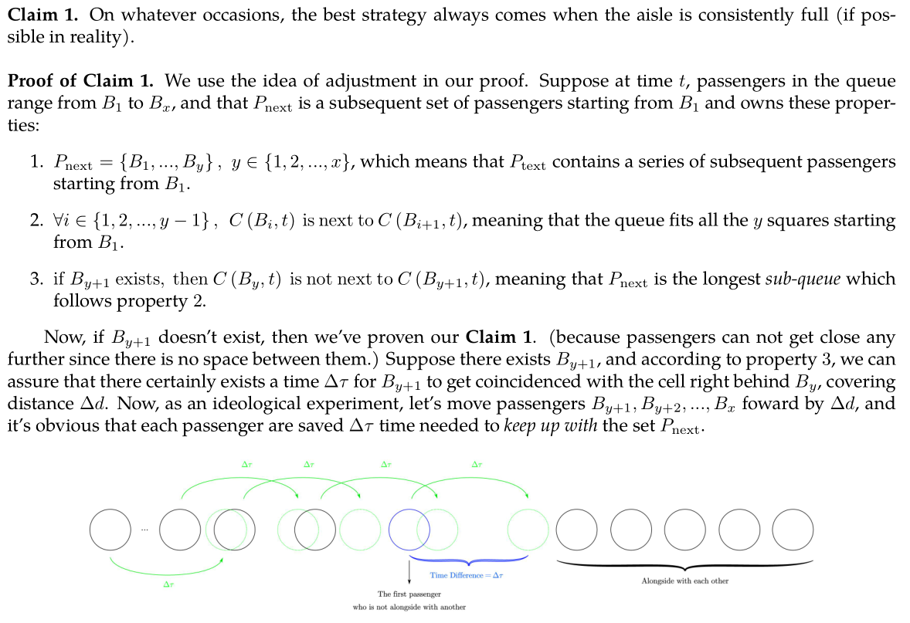
构建数学模型计算登机时间（并行性） Devising a Model to Calculate Total Boarding Time (Parallelity)
Notes:
This is the sketch map.

Slide 37
离机与登机的等效性证明 Proof of Equality Between Boarding and Disembarking
对于每名乘客来说，其离机过程就是其登机过程的逆过程：其运动过程恰好完全相反，从取出行李，经过走廊到抵达飞机入口。
For each passenger, the disembarking process is the reverse of the boarding process: the motivation is quite the opposite, from getting the luggage out, going through the aisle, to reaching the aircraft entrance.
因此，由于过程相似，显然我们可以得到，离机的最佳策略和登机类似，也要让过道尽量被占用，以达到最高的并行性。
Thus because of the similar process, it’s obvious that the best disembarking strategy is similar to embarking: to make sure the aisles are used to maximize the parallelity.
然而，不同点是，在离机过程中，由于乘客都忙于取行李，根本不存在让位的可能（因为走廊被堵住）。因此，每一排上乘客的离机顺序就是简单的从外到内。由于离机时每一个走廊单元格都能被拿行李或缓慢行进的乘客占用，相当于乘客以理想方式排队，并行性高于登机，因此离机所需时间会短于登机。
However, the difference is that during disembarking, there’s no possibility of offering cells for the aisle is blocked when passengers are getting the luggage out. Thus the disembarking sequence of each row is simply aisle to window. All the aisle cells can be occupied, passengers getting luggage out or walking slowly, the same as queuing in the ideal way, having higher parallelity than boarding, the time needed is shorter than boarding.
Notes:
Disembarking is almost just the reverse of boarding, for the motion is just the reverse from boarding. So the best strategy should be similar to boarding. However, for there’s no offering cells, the passengers have already been in an ideal queue, thus spending less time than boarding because of higher parallelity.

Slide 38
满意度指数 Satisfaction Index
对于任意一种方案，乘客可能会由于某些因素而感到不满意。根据我们对现实生活中坐飞机的经历，有这样几个主要因素：
For whatever method, passengers may feel unsatisfied due to various reasons. According to our experience in real life, here are some major factors:
排队时间 Queuing time
让座时间 Time offering seats
同一排内乘客登机时间的标准差 The standard variance of the boarding time of the passengers in the same row
这个因素的引入是为了考虑坐在同一排的同行（一般是家庭）的旅客被拆散登机带来的不满意度
This factor was introduced to consider the dissatisfaction of the split of the fellow passengers (usually families) in the same row
这个因素因为误删没有在论文中显示，后文突然出现可能会显得突兀
This factor was unexpectedly unshown in the essay so it may be abrupt when appearing later
总不满意度是这三个因素的加权和，三个因素的权值分别是1，250与10
The total dissatisfaction is the weighted sum of the three factors, the weight respectively 1, 250 and 10.
Notes:
Besides the total time, passengers’ satisfaction is also an important factor to take into account. In real-life experiences, dissatisfaction mainly comes from queuing and offering seats. And according to the strict sequence, some fellow passengers may be split, causing some dissatisfaction (though mistakenly not written in the essay). The total dissatisfaction index is the weighted sum of the three factors.

Slide 39
满意度指数 Satisfaction Index
为什么是1，250，10三个数？
Why 1, 250 and 10?
1是为了标准化
1 is for standardization
其他数字是为了统一三个因素的量级（显然排队的时间长于让座的时间但让座引起的不满更大），同时第三个因素的影响也很大，但同行旅客占比较低
The other figures are for uniting the magnitudes (obviously the time queuing is longer than the time offering seats, but the latter is more dissatisfying; the third factor is also important but there’re few fellow passengers
较为统一的量级可以使最终的总满意指数综合这三项指标，而不是偏重其中某一项
United magnitudes can make the ultimate dissatisfaction index combine the three indexes instead of tending to one of them
Notes:
The weights of the factors are respectively 1, 250 and 10. The reason for 1 is for standardization, and 250 and 10 are according to real-life experience, and also to unite magnitudes to prevent one factor to affect the total index too much.

Slide 40
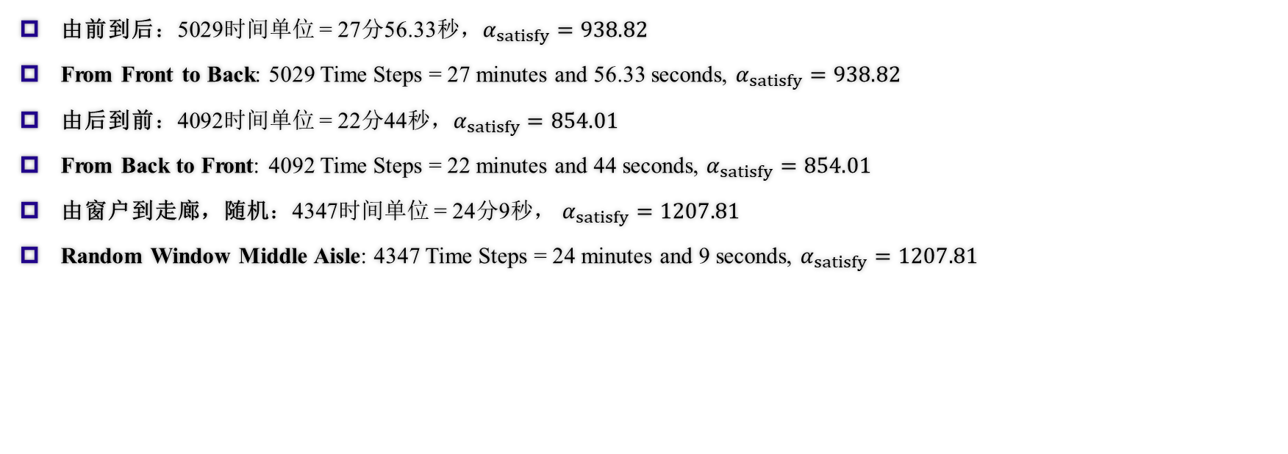
模拟结果 Results of Simulation
由前到后：5029时间单位 = 27分56.33秒，$α_{satisfy}=938.82$
From Front to Back: 5029 Time Steps = 27 minutes and 56.33 seconds, $α_{satisfy}=938.82$
由后到前：4092时间单位 = 22分44秒，$α_{satisfy}=854.01$
From Back to Front: 4092 Time Steps = 22 minutes and 44 seconds, $α_{satisfy}=854.01$
由窗户到走廊，随机：4347时间单位 = 24分9秒， $α_{satisfy}=1207.81$
Random Window Middle Aisle: 4347 Time Steps = 24 minutes and 9 seconds, $α_{satisfy}=1207.81$
Notes:
These are the results we got through the simulation of our code (read and compare, simply)

Slide 41
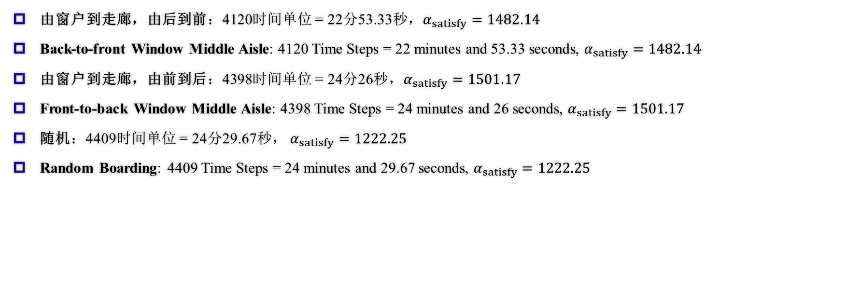
模拟结果 Results of Simulation
由窗户到走廊，由后到前：4120时间单位 = 22分53.33秒，$α_{satisfy}=1482.14$
Back-to-front Window Middle Aisle: 4120 Time Steps = 22 minutes and 53.33 seconds, $α_{satisfy}=1482.14$
由窗户到走廊，由前到后：4398时间单位 = 24分26秒，$α_{satisfy}=1501.17$
Front-to-back Window Middle Aisle: 4398 Time Steps = 24 minutes and 26 seconds, $α_{satisfy}=1501.17$
随机：4409时间单位 = 24分29.67秒， $α_{satisfy}=1222.25$
Random Boarding: 4409 Time Steps = 24 minutes and 29.67 seconds, $α_{satisfy}=1222.25$
Notes:
These are the results we got through the simulation of our code (read and compare, simply)

Slide 42
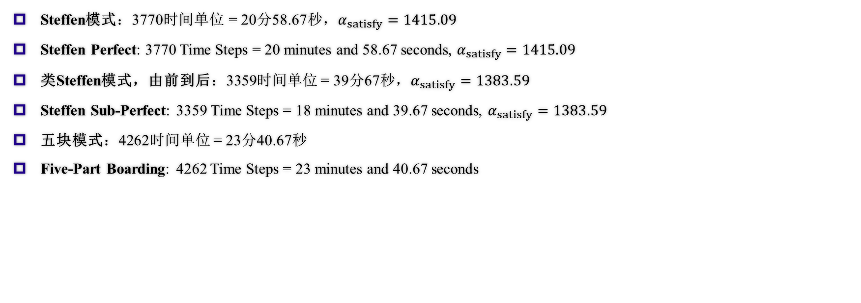
模拟结果 Results of Simulation
Steffen模式：3770时间单位 = 20分58.67秒，$α_{satisfy}=1415.09$
Steffen Perfect: 3770 Time Steps = 20 minutes and 58.67 seconds, $α_{satisfy}=1415.09$
类Steffen模式，由前到后：3359时间单位 = 39分67秒，$α_{satisfy}=1383.59$
Steffen Sub-Perfect: 3359 Time Steps = 18 minutes and 39.67 seconds, $α_{satisfy}=1383.59$
五块模式：4262时间单位 = 23分40.67秒
Five-Part Boarding: 4262 Time Steps = 23 minutes and 40.67 seconds
Notes:
These are the results we got through the simulation of our code (read and compare, simply)

Slide 43
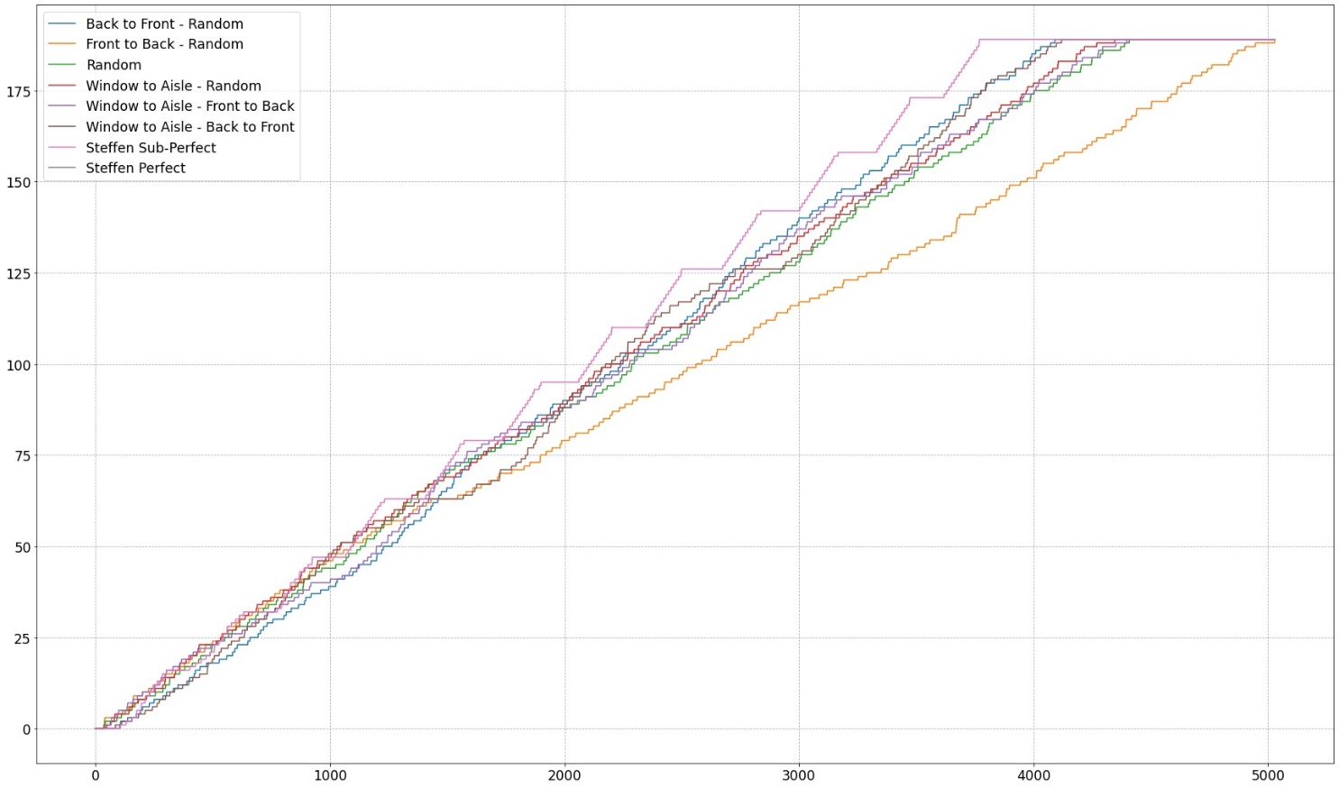
模拟结果 Results of Simulation
Notes:
This is a graph to compare between several ways. We can see that Steffen Sub-Perfect performs the best overall with Steffen Perfect following, and back-to-front, windle-to-aisle following, It is obvious that the random method even outweigh front-to-back method.

Slide 44
敏感度分析 Sensitivity Analysis
如何对我们的模型进行敏感度分析？
How to conduct a Sensitivity Analysis on Our Model?
使用拟合程度进行定量衡量
Use Compliancy Index to measure in Figure
对改变的可预测性
Predictable of Changes
事实证明的变化关系
Relationship proved by Facts
Notes:
We need to conduct a sensitivity analysis on our model, but how? We use compliancy index to measure in figure. It shows the predictability of changes of the model, and the function to compare with is a relationship proved by facts.

Slide 45
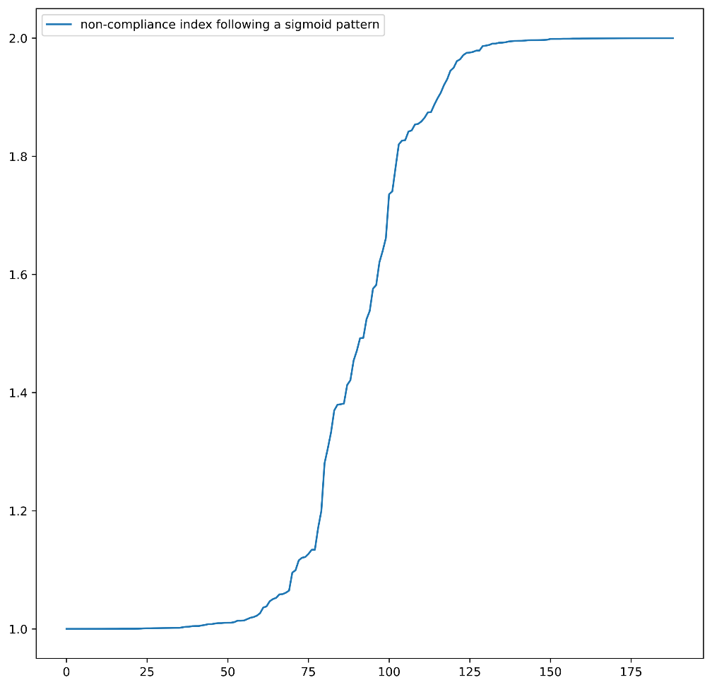
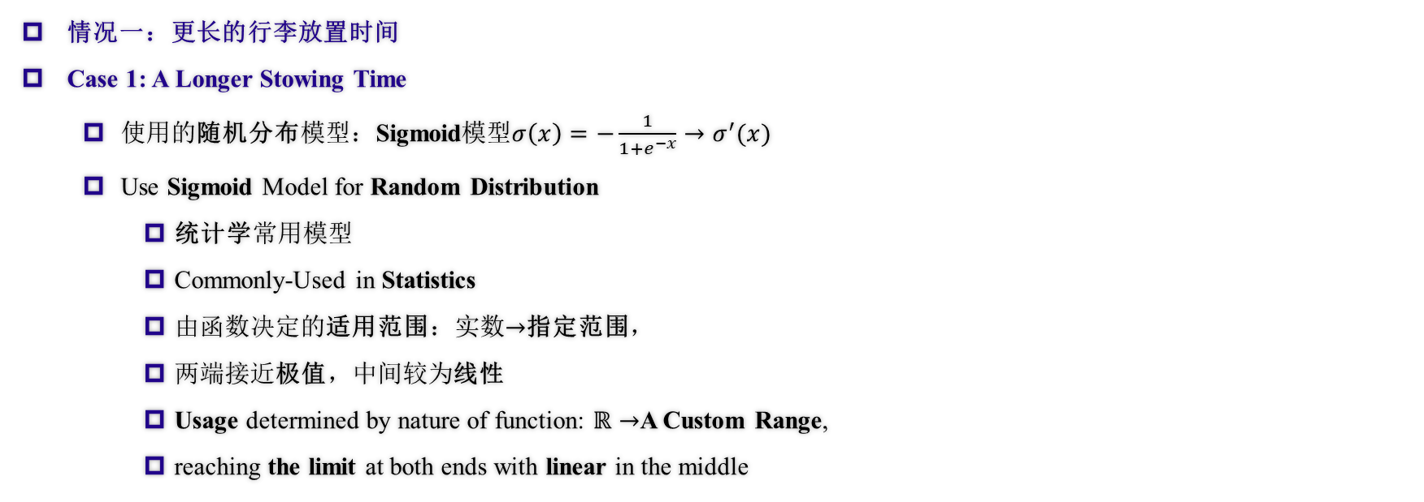
敏感度分析 Sensitivity Analysis
情况一：更长的行李放置时间
Case 1: A Longer Stowing Time
使用的随机分布模型：Sigmoid模型$σ\left(x\right)=−\frac{1}{1+e^{−x}}→σ^{′}(x)$
Use Sigmoid Model for Random Distribution
统计学常用模型
Commonly-Used in Statistics
由函数决定的适用范围：实数$→$指定范围，
两端接近极值，中间较为线性
Usage determined by nature of function: $ℝ→$A Custom Range,
reaching the limit at both ends with linear in the middle
图：Sigmoid模型范例
Fig. Sigmoid Model Demonstration
Notes:
Case one of our Sensitivity Analysis is a longer stowing time. We use a random model – sigmoid model – as shown in the slides, to distribute the dicompliance of passengers in a relatively realistic method. The reason why we choose the sigmoid model is due to its speciality in it’s functions and value, as shown in the figure to the right.

Slide 46
敏感度分析 Sensitivity Analysis
情况一：更长的行李放置时间
Case 1: A Longer Stowing Time
如何区分稳定和不稳定？（总体尺度上）
How to distinguish between Stable and Unstable? (Overall Timestep)
稳定：线性图像
Stable: Linear Graph
不稳定：无明显规律
Unstable: No Obvious Relationship
方差（差异化程度）的图像
The Graph of Variance
稳定：先为上凸函数（变化率逐渐递减），后为线性
Stable: Rate of Changing Decrease followed by Linear
不稳定：无线性阶段
Unstable: No Linear State
Notes:
How to distinguish stable and unstable on overall timestep? It is obvious that, if a method is stable, its graph (timestep – discompliancy) should be a linear one, while if it is unstablem, that should have no obvious relationship. Determining the stability can also be based on variance: if stable, then it should be expomential (rate of changing decrease) and followed by a linear function; if not, there shouldn’t be any obvious linear state.

Slide 47
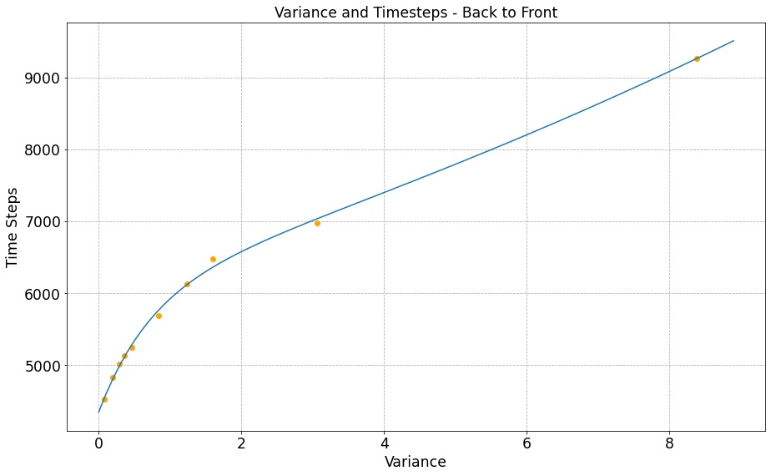
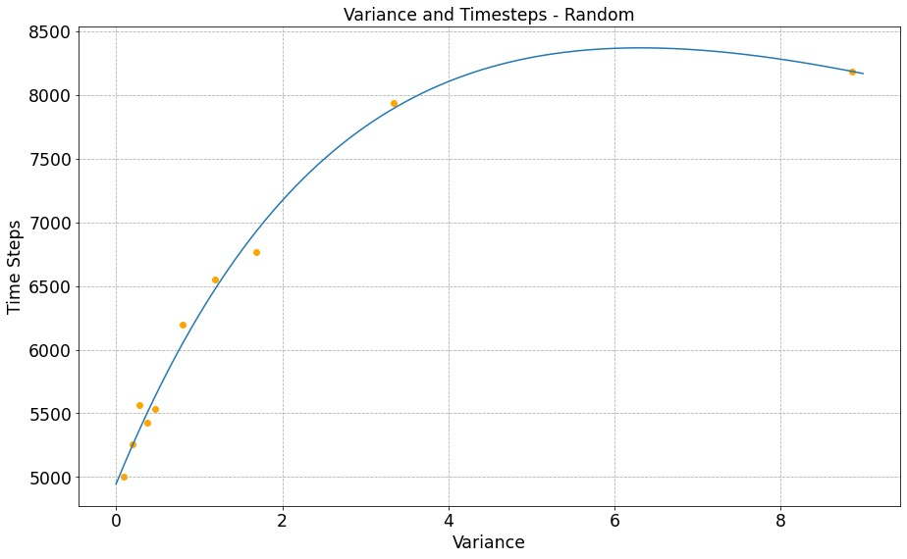
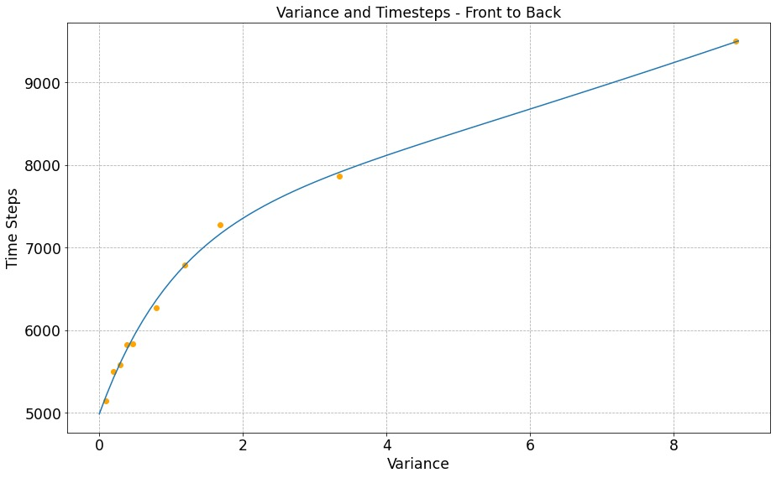
敏感度分析 Sensitivity Analysis
情况一：更长的行李放置时间
Case 1: A Longer Stowing Time
图：放置行李时间影响比较（方差）
Fig. Comparison on Longer Stowing Time, Variance
Notes:
These are three graphs of variance-timesteps back to front.

Slide 48
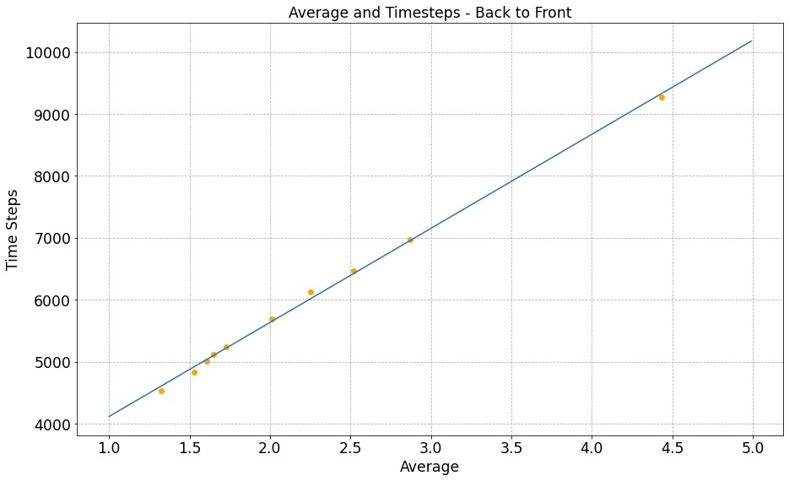
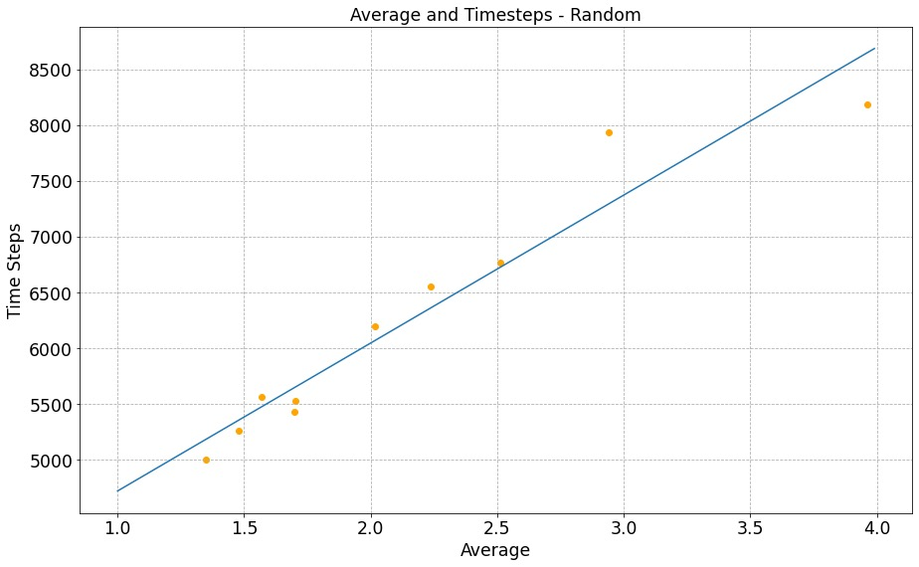
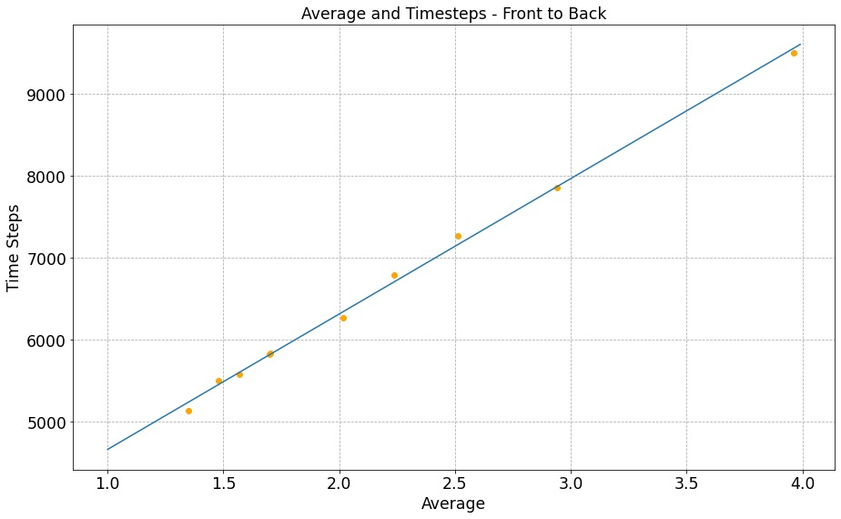
敏感度分析 Sensitivity Analysis
情况一：更长的行李放置时间
Case 1: A Longer Stowing Time
随机登机敏感度较高，由前到后登机敏感度较低
Random boarding is the most sensitive while Front-to-Back method seems totally not sensitive
图：放置行李时间影响比较（总时间）
Fig. Comparison on Longer Stowing Time, Overall Time
Notes:
We can draw the conclusion that random boarding is the most sensitive while front-to-back seems totally not sensitive.

Slide 49
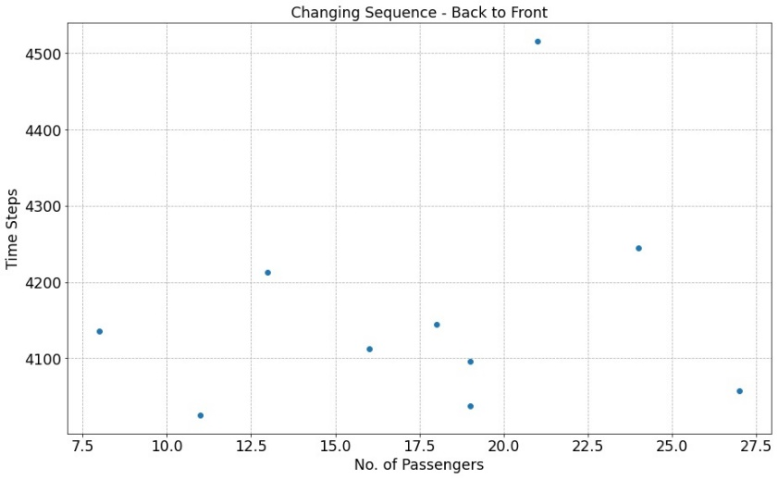
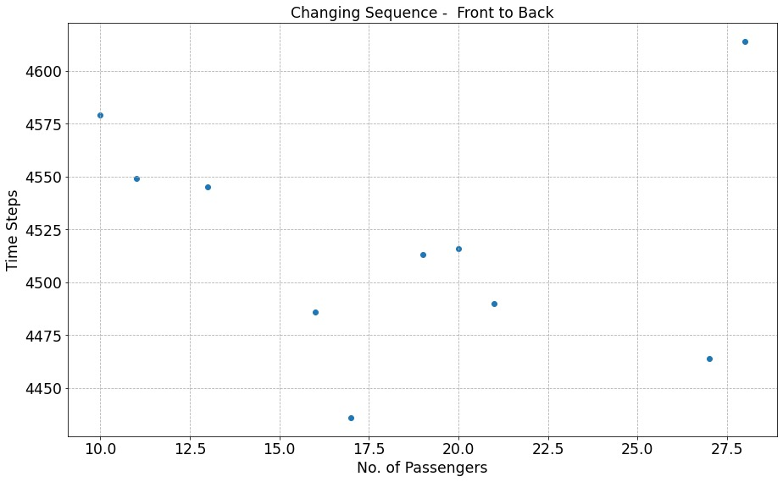
敏感度分析 Sensitivity Analysis
情况二：插队
Case 2: Queue Jumping
两个方案均为敏感方案，会对结果造成巨大的影响
Both Methods are Sensitive which makes Big Impact on Total Results
图：插队影响比较
Fig. Comparison on Queue Jumping
Notes:
Next, we analyzed queue-jumping situation and drew the conclusion that both methods are sensitive which means queue-jumping makes big impact on total results

Slide 50
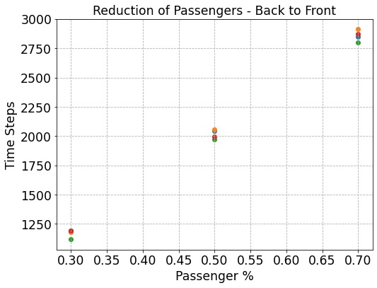
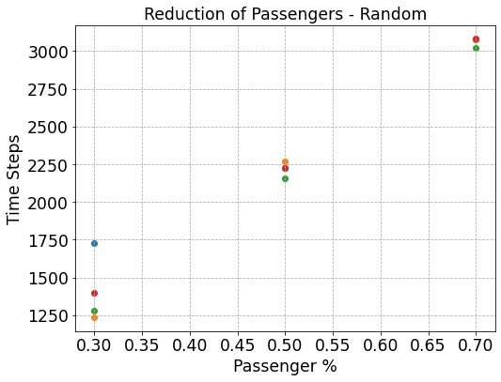
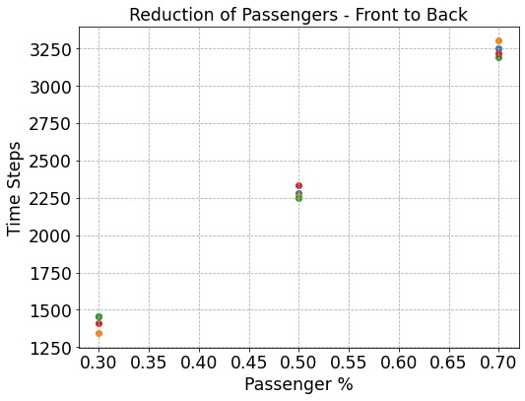
敏感度分析 Sensitivity Analysis
情况三：乘客数量的减少
Case 3: Reduction of Passengers
随机登机最为敏感（点的分布最远），由后到前登机依然十分稳定
Random Boarding is the most Sensitive (Furthest Distribution of Points), Back-to-Front Method still not so sensitive
图：乘客人数减少影响比较
Fig. Comparison on Reducing Passengers
Notes:
Last but not least, we conducted a research on the reduction of passengers, and found out that random boarding is the most sensitive (see the distribution of points) while back-to-front is not so sensitive.

Slide 51
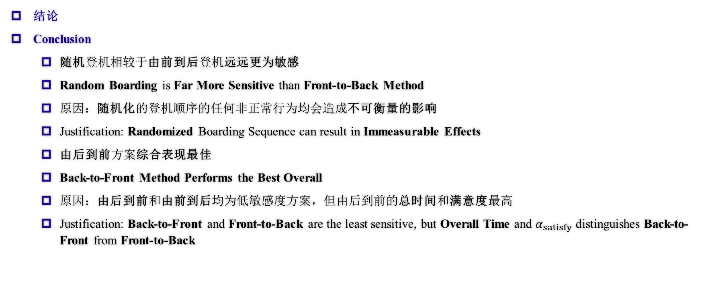
敏感度分析 Sensitivity Analysis
结论
Conclusion
随机登机相较于由前到后登机远远更为敏感
Random Boarding is Far More Sensitive than Front-to-Back Method
原因：随机化的登机顺序的任何非正常行为均会造成不可衡量的影响
Justification: Randomized Boarding Sequence can result in Immeasurable Effects
由后到前方案综合表现最佳
Back-to-Front Method Performs the Best Overall
原因：由后到前和由前到后均为低敏感度方案，但由后到前的总时间和满意度最高
Justification: Back-to-Front and Front-to-Back are the least sensitive, but Overall Time and $α_{satisfy}$ distinguishes Back-to-Front from Front-to-Back
Notes:
These are the major conclusions that can be drawn from our sensitivity analysis: Random is far more sensitive than front to back, because of randomized sequence can result in immeasurable effects. Back-to-front is the best overall, because it is the least sensitive and has a better overall time and satisfaction.

Slide 52
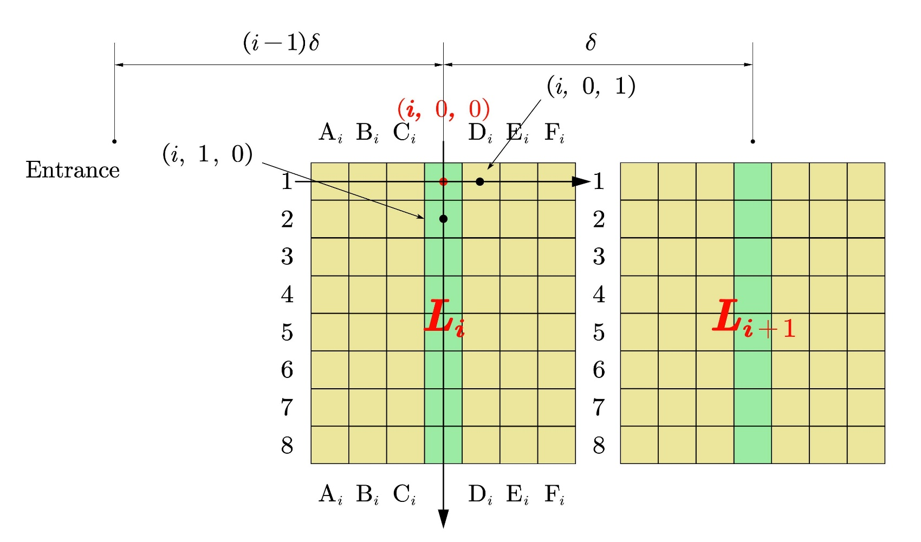
应用到不同机型（坐标划分） Application to Different Aircrafts (The division of coordinates)
Flying Wing Aircraft
采用了三维坐标形式
We adopted three-dimensional coordinates.
将每一块看作互相独立的部分
We see every block as independent parts
Main Aisle Cells
Block Aisle Cells
图 Flying Wing 坐标划分
Division of coordinates in Flying Wing
Notes:
For the Flying Wing aircraft, as we've already divided it into four blocks, we define the intersection point of the main aisle and the ith block aisle as (i, 0, 0), and the ith block aisle as its x-grid. And for the TETA aircraft, we define the entrance cell in the left as (0, 0), and the direction of the two aisles as the x-grid. The seats with a negative x-coordinate are the first class. And for the rest, passengers with seats x-coordinated 1 and 9 would board first, while those with 4 and 6 board last.

Slide 53
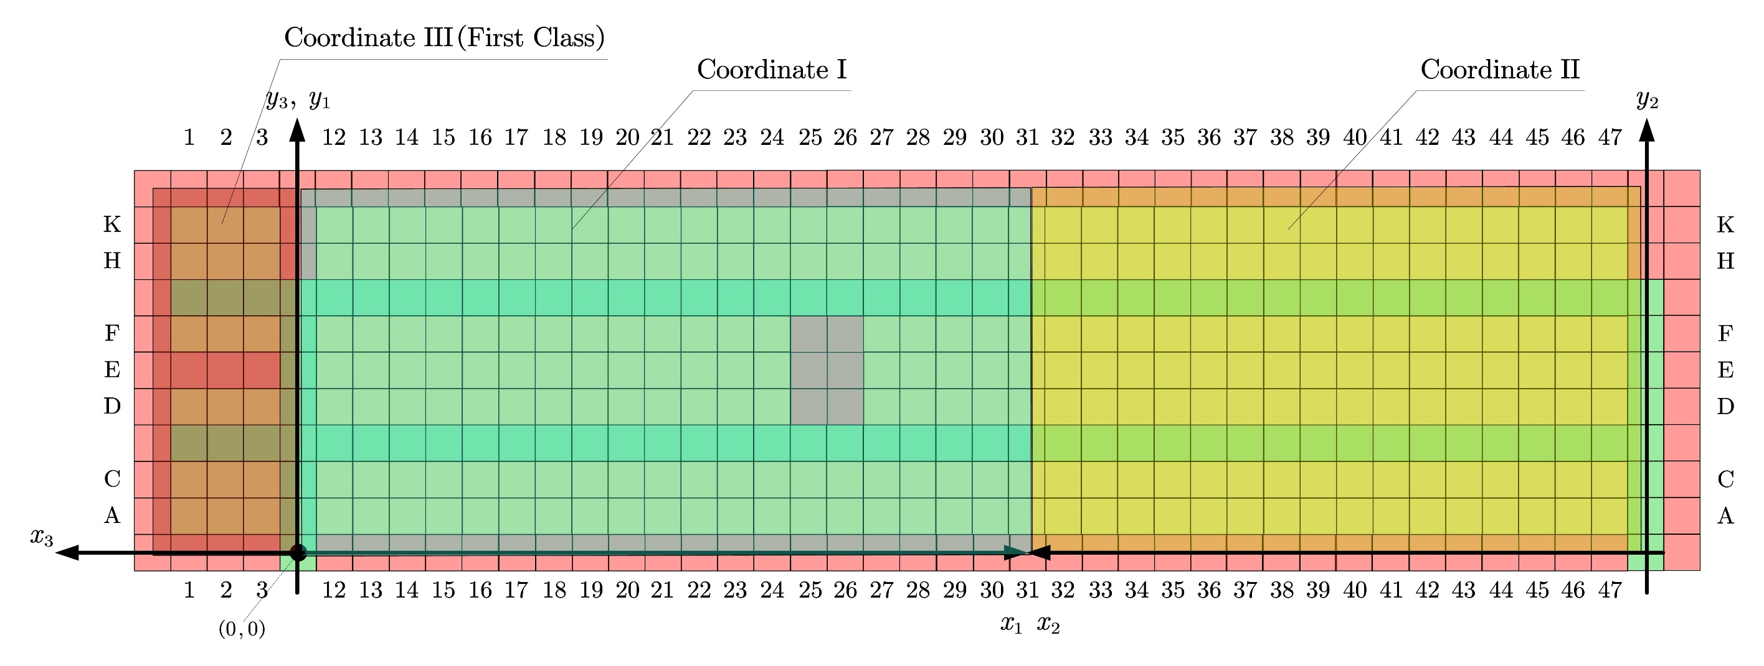
应用到不同机型（坐标划分） Application to Different Aircrafts (The division of coordinates)
图 TETA 坐标划分
Division of coordinates in TETA
Notes:
Here is the coordinates for the TETA Aircraft.

Slide 54
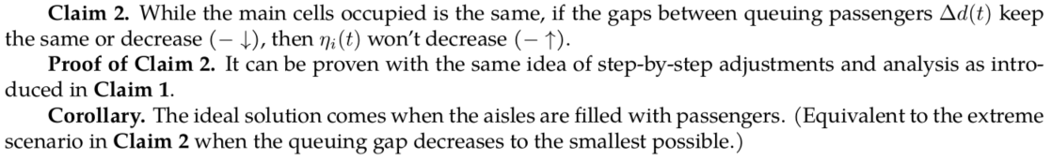
应用到不同机型（准备部分） Application to Different Aircrafts (Preparation)

Slide 55


应用到不同机型 Application to Different Aircrafts
主要思想 Key Points
对于TETA和Flying Wing两种多过道的飞机，我们发现，它们可以按照分过道的不同分为几个较小的部分，这几个部分中的乘客在分过道上互不影响。因此，我们可以考虑将这些部分分治处理，每个部分中分别采用最优的登机策略。然后，因为前面已经证明了过道占得越满效率越高的结论，我们只需让主过道占得最满即可。
For TETA and Flying Wing, two kinds of multi-aisle aircrafts, we found that they can be divided into smaller parts according to aisles, and passengers in different parts won’t influence each other on part aisles. So we could consider respectively deal with these parts. We can use the best boarding sequence in each part. Then, for we’ve proved the conclusion that the best strategy is to make full use of the aisles, we only need to make sure the main aisle is full.
Notes:
Here are the main ideas when we apply the model to different aircrafts. TETA and the Flying Wing are two kinds of multi-aisle aircrafts, and we found that they can be divided into smaller individual parts similar to ordinary one-aisle aircrafts.

Slide 56

应用到不同机型 Application to Different Aircrafts
结论 Conclusion
因此，对于这一类的飞机，我们只需要预先将所有乘客按他们所在的小部分进行分组，将每组中的乘客按照组内的登机顺序进行排序，最后再确定组间乘客的登机先后顺序即可。
Thus for this kind of aircrafts, we only need to divide the passengers into groups according to the parts they’re in and sort the passengers in each group according to the sequence of boarding within the group, and finally decide the sequence between groups.
图 理想登机方案
Fig. Ideal Boarding Scheme
Notes:
To optimize the whole plan, it’s obvious that we need to optimize the boarding sequence inside groups, and then we need to optimize the between-group sequences.

Slide 57

应用到不同机型 Application to Different Aircrafts
结论 Conclusion
显然，由于外侧组的乘客可能会堵住主过道影响内侧组的乘客登机，为了确保过道的使用效率，我们应当让内侧组的乘客先登机。同时，为了防止内侧组有人就座之后带来的空单元格，我们决定在外侧组的一些乘客登机之后再安排几个内侧组的乘客，用来补齐这些空单元格。
Obviously, passengers in the outer groups may block the main aisle and influence inner group passengers’ boarding, so we should board inner group passengers first to ensure the used efficiency of aisles. Meanwhile, to prevent empty cells caused by seated inner group passengers, we decided to arrange a few inner group passengers after some outer group passengers have boarded, to fill up the empty cells.

Slide 58
优点 Strengths
准确性
多样性
有效性
Accuracy
Universality
Efficiency
Notes:
We have concluded some of the strengths of our model.
First, accuracy. In our model, we take several special situations into consideration. Also, we use several programs to facilitate our calculation. This makes our result reasonable and precise.
The second strength is universality. In our model, we succeeded in achieving visualization of the plane and successfully simulated the whole process of different boarding methods which has been shown just now. This means that our model can be applied to a variety of problems.
Finally, our model bears efficiency. As shown in the second model, we use a program to facilitate our calculations in finding the best strategy. Therefore, a lot of time is saved and it proved that our model has efficiency.

Slide 59
缺点 Weaknesses
复杂性
难于操作
Complexity
Difficult to operate
Notes:
Also, we have found some weaknesses that needed to be improved.
The first problem is complexity. We introduce a great many variables and a variety of explanations in our model. Some of them are a little bit abstract and some of our calculations conducted by programs aren't shown in this essay. This will make our model more complex and less easy to understand.
The second weakness is that our model is difficult to operate when it comes to reality. As can be seen in the descriptions above, our model provides a plan with some details that must be strictly obeyed. This will increase the difficulty for the crews to let every passenger be aware of the rules. However, we have thought of a method that can ease this kind of difficulty. When there’s a passenger ahead waiting, we can first let him get to his seat. According to our sensitivity analysis, this will not have a big impact on our boarding time. Therefore, this kind of strategy is somehow reasonable and flexible.

Slide 60

给航空公司的建议信 A Letter to Airline Executives
两个主要因素 Two factors:
人性化 Hommization
高效 Efficiency
三条有效建议 Three suggestions:
防止主过道拥堵
Avoid blocks in general aisles.
为行李提供足够空间
Provide enough space for luggage.
防止不必要的插队
Prevent queue-jumping.
Notes:
Based on our model, we write a letter to provide the airline executives with some suggestions. First, we point out two important factors in the whole boarding and disembarking process----that is hommization and efficiency. Later, we draw a simple chart to illustrate our plan. You can look ate the picture in the power point. In addition, we also offer some simple tips that could be applied to all kinds of planes. Airline executives need to prevent passengers from being stuck in general aisles, provide passengers with enough space to place their luggage and prevent queue-jumping.

